Slide 1

Wireless Networking
Ambuj Varshney
ambujv@nus.edu.sg
Notes:
++ Thank you for inviting me to give this talk
++ In this talk, I will present a pathway that can enable us to make wireless embedded systems ubiquitous. I will describe my previous research efforts that tackle the critical challenges that limit the growth of wireless embedded systems. These are related to the growing energy asymmetry that exists between sensing, computation and communication blocks on these platforms.
++ Finally, I will conclude my talk by covering the research agenda that I would like to work on as a faculty member.

Slide 2
Discussion regarding Assignment 2
Assignment 2: Deadline 18th March
Submission after deadline: Penalty of 10% Per Day (until 24th March)
Submission link is now available on the Canvas
Please submit a readme file, source code, statement of work and a video demonstrating the operation of the sensor tag. The statement of work should describe the contribution made by every member of the group. You need to submit the source code for Task 2 and Task 3 as separate files. Only one member should submit the assignment on the canvas.
Notes:
++ We may all have heard of the term Internet of Things. So how are these wireless embedded systems related to the Internet of Things: Today, IoT includes a broad class of devices, including powerful platforms such as smartphones. However, it also includes more resource-constrained devices and what we call Wireless Embedded Systems, and in fact, I consider it to be one of the essential parts of the IoT ecosystem.
++ These are platforms equipped with a radio transceiver, sensor, microcontroller, and some form of energy storage. These platforms also often form a network, and sensor network as it is called has been an active area of research for the past two decades.
++ The research community has also developed wireless embedded platforms which we may know about, and these include: CMUCAM, which is an image sensor platform developed at Carnegie Mellon University, or Permamote is long life sensor platform from the lab I am associated with at UC Berkeley or Lorea which is a long-range backscatter platform that I had developed as part of my doctoral dissertation at Uppsala University. All of these are an example of Wireless Embedded Systems.

Slide 3
Roadmap of the lecture today
Let us recall what was covered in the last lecture
Energy consumption calculation
Low-power wireless transmissions using backscatter mechanism
Backscatter like mechanism and LiFi
Communication layers and medium access control
Notes:
Here is the roadmap of the major topics that I am going to cover during the presentation. We have already covered the exponential growth of the internet of things; next, I will talk about the critical energy challenge that can severely hinder this massive growth and preventing us from realising this immense economic value enabled by the IoT.

Slide 4
Let us review the last lecture

Slide 5
Quick revision of important terms and their unit
Voltage: Volts (V): the SI unit of electromotive force
Current: Ampere or “amp” (A) is the SI unit of current
Power (W): Voltage (V) x Current (A)
Energy (Joule): Power x Time.
Example:
A device running at 1V draws 1A.
The power consumption is therefore 1W
Energy consumed in 1s is 1J

Slide 6
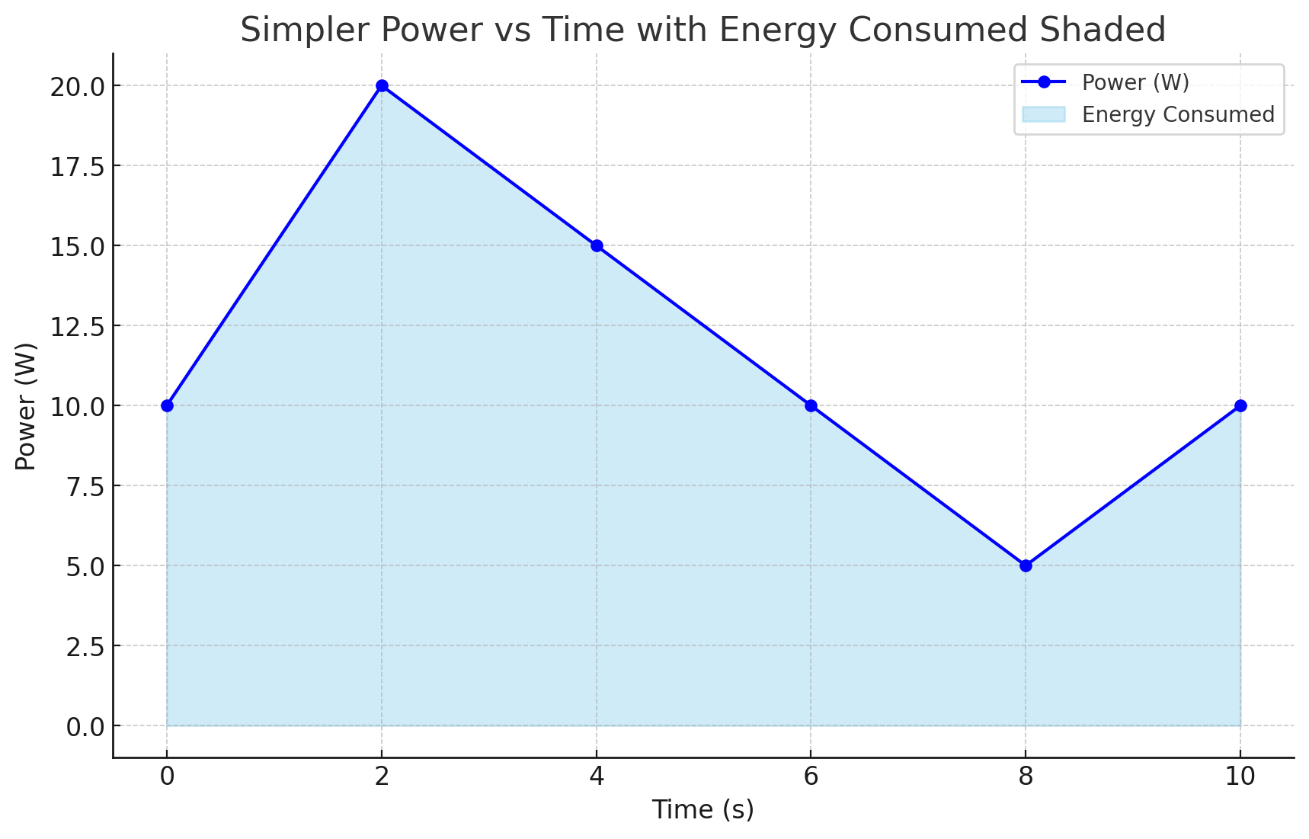
Relationship between power, energy and time

Slide 7
How do you measure the capacity of a battery?
The watt-hour (symbolized Wh) is a unit of energy equivalent to one watt (1 W) of power that is expended for one hour (1 h) of time.
Macbook Pro 16 Inch: 99.6 Watt-hour
iPad pro 12.9 Inch: 40.88 Watt-hour
An ampere-hour or amp-hour (Ah) is a unit of electric charge equal to the charge transferred by a steady current of 1A flowing for one hour:
AA Energizer Alkaline: 2500 mAh (1.5V), 3.75Wh

Slide 8
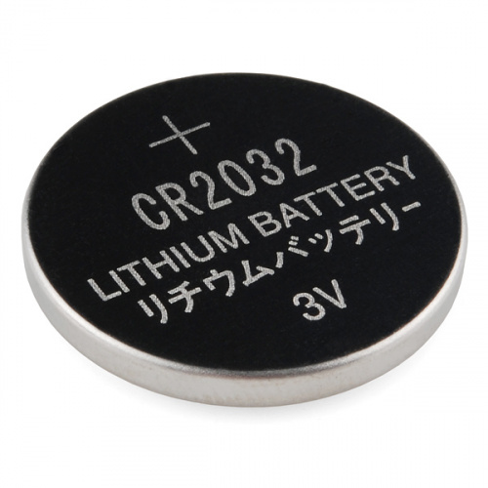
What is the capacity of the battery?
How do we calculate the lifetime of the battery in IoT devices?
We express battery capacity commonly in milliampere-hour (mAH)
Coin cell (CR2032): 240 mAh, Flexible battery (Molex): 10 mAh
How long would battery last under different device load:
Current drawn | Lifetime
240 mA | 1 h
120 mA | 2 h
1 mA | 240 h
Coin cell battery
CR 2032 (240 mAh)

Slide 9
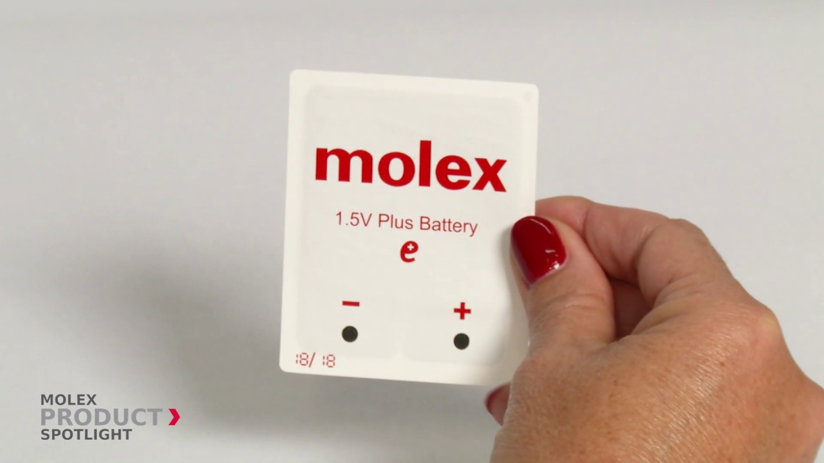
Expected lifespan of a battery in an IoT devices?
Coin cell (CR2032): 240 mAh, Flexible battery (Molex): 10 mAh
What is the battery life under different device loads:
Coin cell battery
CR 2032 (240 mAh)
Flexible Battery
(10 mAh)
Component | Current draw | Flexible Battery | Coin cell
Microcontroller | 200 uA | 50 h | 1200 h
Accelerometer | 10 uA | 1000 h | 24000
WiFi Radio | 15 mA | 45 mins | 16 h
Bluetooth radio | 1 mA | 10 h | 240 h

Slide 10
Spikes in the power consumption of smartphones are due to wireless networking events
WiFi state transition for beacon communication is (relatively) fast
However, state transition for data communication is (still) slow due to driver/software overhead

Slide 11
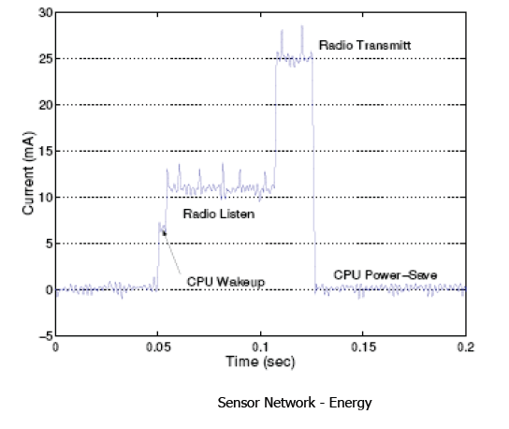
Current consumption for a wireless embedded device for various states of the radio transceiver

Slide 12
Roadmap of the lecture today
Let us recall what was covered in the last lecture
Energy consumption calculation
Low-power wireless transmissions using backscatter mechanism
Backscatter like mechanism and LiFi
Communication layers and medium access control
Notes:
Here is the roadmap of the major topics that I am going to cover during the presentation. We have already covered the exponential growth of the internet of things; next, I will talk about the critical energy challenge that can severely hinder this massive growth and preventing us from realising this immense economic value enabled by the IoT.

Slide 13
Energy consumption calculation for an embedded device

Slide 14
Lifespan calculation for an embedded device
Illustrative readings for different state of radio transceiver:
Idle power consumption(MCU) : 10mA
Transmitting (PTX) : 20mA
Receiving (PRX) : 10mA
Sleeping : 0.1mA
Battery = 2 (1.5V) AA batteries, each provides 2300 mAh
Total battery capacity = 2 * 1.5 * 2.3 = 6.9Wh

Slide 15
Lifespan calculation for a embedded device
The clock frequency of the microcontroller: 48 MHz
What is one clock cycle?

Slide 16
Lifespan calculation for a embedded device
The clock frequency of the microcontroller: 48 MHz
What is one clock cycle? 20.8 nanoseconds

Slide 17
Lifespan calculation for a embedded device
The clock frequency of the microcontroller: 48 MHz
What is one clock cycle? 20.8 nanoseconds
Please assume the following:
Average instructions takes 8 clock cycles
The task takes on an average 20,000 cycles
How much time is taken for execution of the tasks?

Slide 18
Lifespan calculation for a embedded device
The clock frequency of the microcontroller: 48 MHz
What is one clock cycle? 20.8 nanoseconds
Please assume the following:
Average instructions takes 8 clock cycles
The task takes on an average 20,000 cycles
How much time is taken for execution of the tasks?
8 * 20000 * 20.8 (nano seconds) = 3.32 milliseconds
Current drawn per compute cycle: 3.32 * 10 mA = 0.0332 mAs

Slide 19
Lifespan calculation for a embedded device
Data rate for wireless transmissions: 250 kilobits/second
Amount of data to be transmitted: 50 bytes
Time taken = (50 * 8)/250000 = 1.6ms
Current drawn (transmit + CPU) = 30mA
Current drawn
= 30 * 1.6
= 0.048mAs

Slide 20
Lifespan calculation for a embedded device
IoT device continuously transmits information (radio is always active)
What is the lifespan of the device?
Battery capacity: 2300 mAH which is equivalent to (2300 * 3600) mAs
Current consumption for transmissions (per 1.6 ms): 0.048 mA-s
Current drawn: (0.048/1.6) * 1000 = 30 mA
Lifespan for the device: (2300 * 3600) / 30 = 76.67 Hours

Slide 21
Lifespan calculation for a embedded device
IoT device continuously computes (without radio)
What is the lifespan of the device?
Battery capacity: 2300 mAH which is equivalent to (2300 * 3600) mAs
Current drawn per compute cycle: 3.32 * 10 mA = 0.0332 mAs
Current drawn: 10 mA
Lifespan: (2300 * 3600)/10 = 230 Hours

Slide 22
Lifespan calculation for a embedded device
IoT device transmits once every second
Transmission time: 1.6 milliseconds (30 mA)
Compute time: 3.32 millisecond (10 mA)
sleep time: 995.08 milliseconds (0.1 mA)
What is the lifespan of the device?
Battery capacity: 2300 mAH which is equivalent to (2300 * 3600) mAs
Lifespan: ?

Slide 23
Lifespan calculation for a embedded device
Let sensor node operates once a second
Lifetime =

Slide 24
Roadmap of the lecture today
Let us recall what was covered in the last lecture
Energy consumption calculation
Low-power wireless transmissions using backscatter mechanism
Backscatter like mechanism and LiFi
Communication layers and medium access control
Notes:
Here is the roadmap of the major topics that I am going to cover during the presentation. We have already covered the exponential growth of the internet of things; next, I will talk about the critical energy challenge that can severely hinder this massive growth and preventing us from realising this immense economic value enabled by the IoT.

Slide 25
Low-Power Wireless Transmissions through Backscatter Communication

Slide 26
Basics of backscatter communication
Vary between absorbing or reflecting signal to modulate data
Wireless transmissions at microwatts of power draw (10000x energy savings)
Frequency bands: 400 MHz, 900 MHz, 2.4 GHz
Ambient RF signal
Antenna
Reflected (backscatter) signal
RF Switch
Modulating Signal (Digital)
Backscatter tag
Reader/ Receiver

Slide 27

One way to understand backscatter mechanism
Notes:
It can be thought of as a wireless equivalent of reflecting light using a mirror.

Slide 28
Backscatter transmits at (up to) 10000x lower power consumption than conventional radios
Backscatter through absorption or reflection of ambient wireless signals enables wireless transmissions at microwatts of power consumption
Ambient RF signal
Antenna
Reflected (backscatter) signal
RF Switch
Modulating Signal (Digital)
Backscatter tag
Receiver
Notes:
Backscatter communication actually help us overcome this limitation

Slide 29
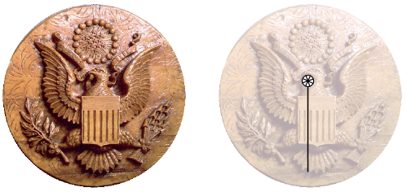
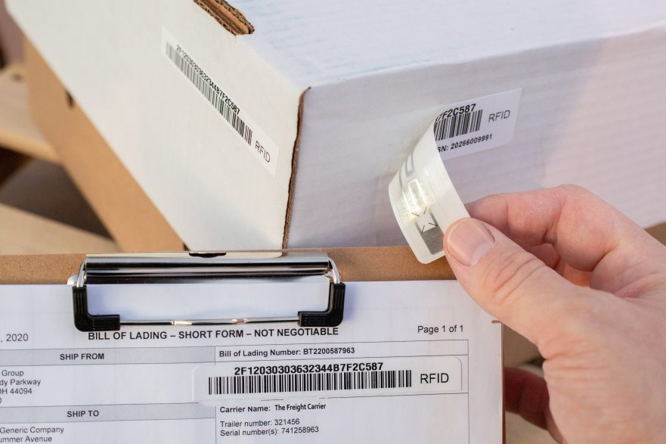
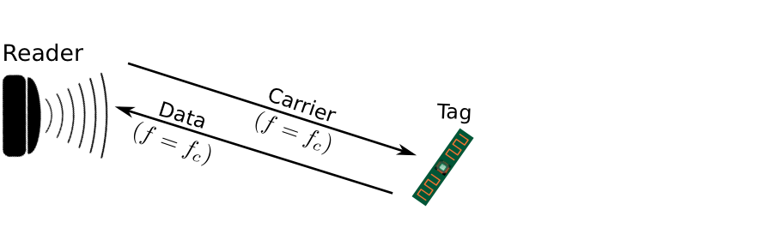
Backscatter is not a new transmission mechanism
First backscatter system: Great seal bug (The Thing) 1945
RFIDs: one of the most widely deployed backscatter system
Great Seal Bug (Backscatter device embedded for spying)
RFID System

Slide 30
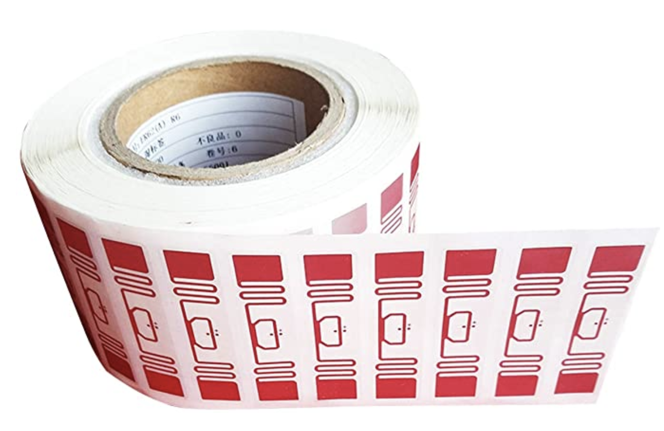
RFID is everywhere nowadays
Fundamental design principle is asymmetry
Extremely simple, cheap tags
Complex readers

Slide 31
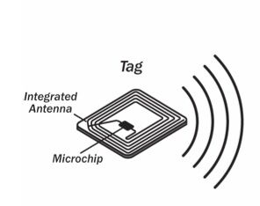
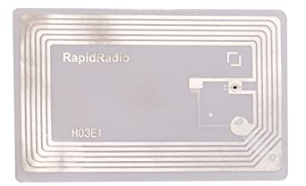
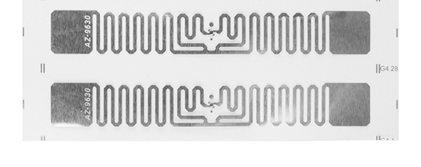
Radio Frequency ID
Cheap, low-power ubiquitous communication
RFID tags on (or in) products
NFC communication to/from smartphone
Requirements
Need to transmit small amount of data (ID)
Need to operate with little or no energy
Most do not have batteries
Short interaction time (fast enough bit rate)
Range can be extremely limited
Meters to centimeters (or millimeters)

Slide 32
Let’s look at RFID standards to get a sense of the numbers
Low Frequency (~300 kHz) — mostly legacy
~10cm read range (inductive coupling)
High Frequency (3~30 MHz; often 13.56 MHz)
Passive: 4~7 m max
Semi-Passive: 10~30 m max
Active: 30+ m
Ultra-High Frequency (300 MHz ~ 3 GHz)
Passive: Up to 12 m (backscatter)
Active: Up to 100 m

Slide 33
RFID challenges
Essentially free communication!
What’s the cost (besides having a higher-capability device)
Difficult to reflect energy when it is already so low
Essentially double the path loss (there and back)
Range is very limited (or transmit power needs to be high)
Meters of range, maximum
Centimeters for inductive coupling
Alternatively, could decouple signal generation from reception

Slide 34

Reflecting FM Signals for Transmissions
Courtesy: University of Washington, Seattle
FM Backscatter: Enabling Connected Cities and Smart Fabrics, USENIX NSDI 2017

Slide 35
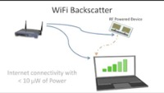
Reflecting WiFi Signals for Transmissions
Courtesy: University of Washington, Seattle

Slide 36
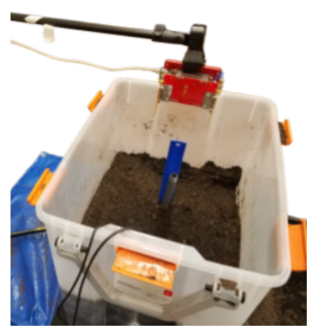
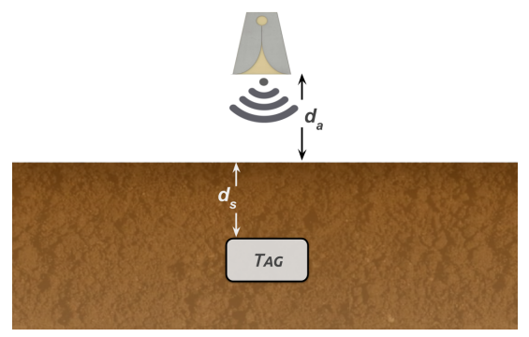
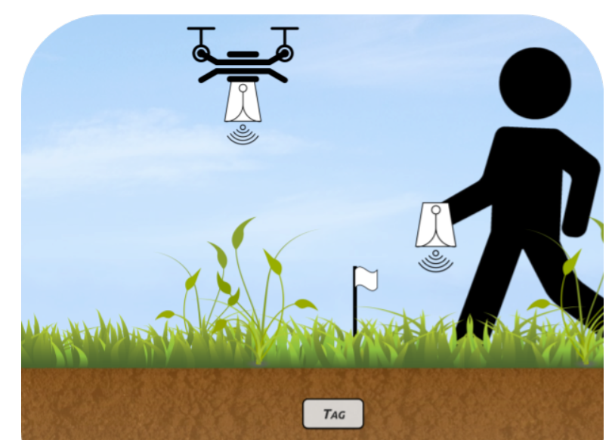
Backscatter as a sensor: soil moisture
Idea: bury backscatter tags in soil
Measure round-trip-time for signal to reflect
T_{s} (time signal travels through ground) changes based on the moisture in the soil
Josephson, Colleen, et al. "Low-cost In-ground Soil Moisture Sensing with Radar Backscatter Tags.“ COMPASS 2021

Slide 37
Long-range Backscatter Communication
Notes:
++ Over the past few years, I have designed several backscatter and beyond backscatter systems that precisely overcome these critical challenges that have limited the widespread deployment of backscatter on IoT devices.
++ The research vision that I have pursued and would like to pursue as a faculty member is to enable a massive deployment of IoT devices by bridging the energy asymmetry between sensing, computation and communication blocks by designing novel platforms and communication mechanisms. I am going to describe some of my research contributions next.

Slide 38
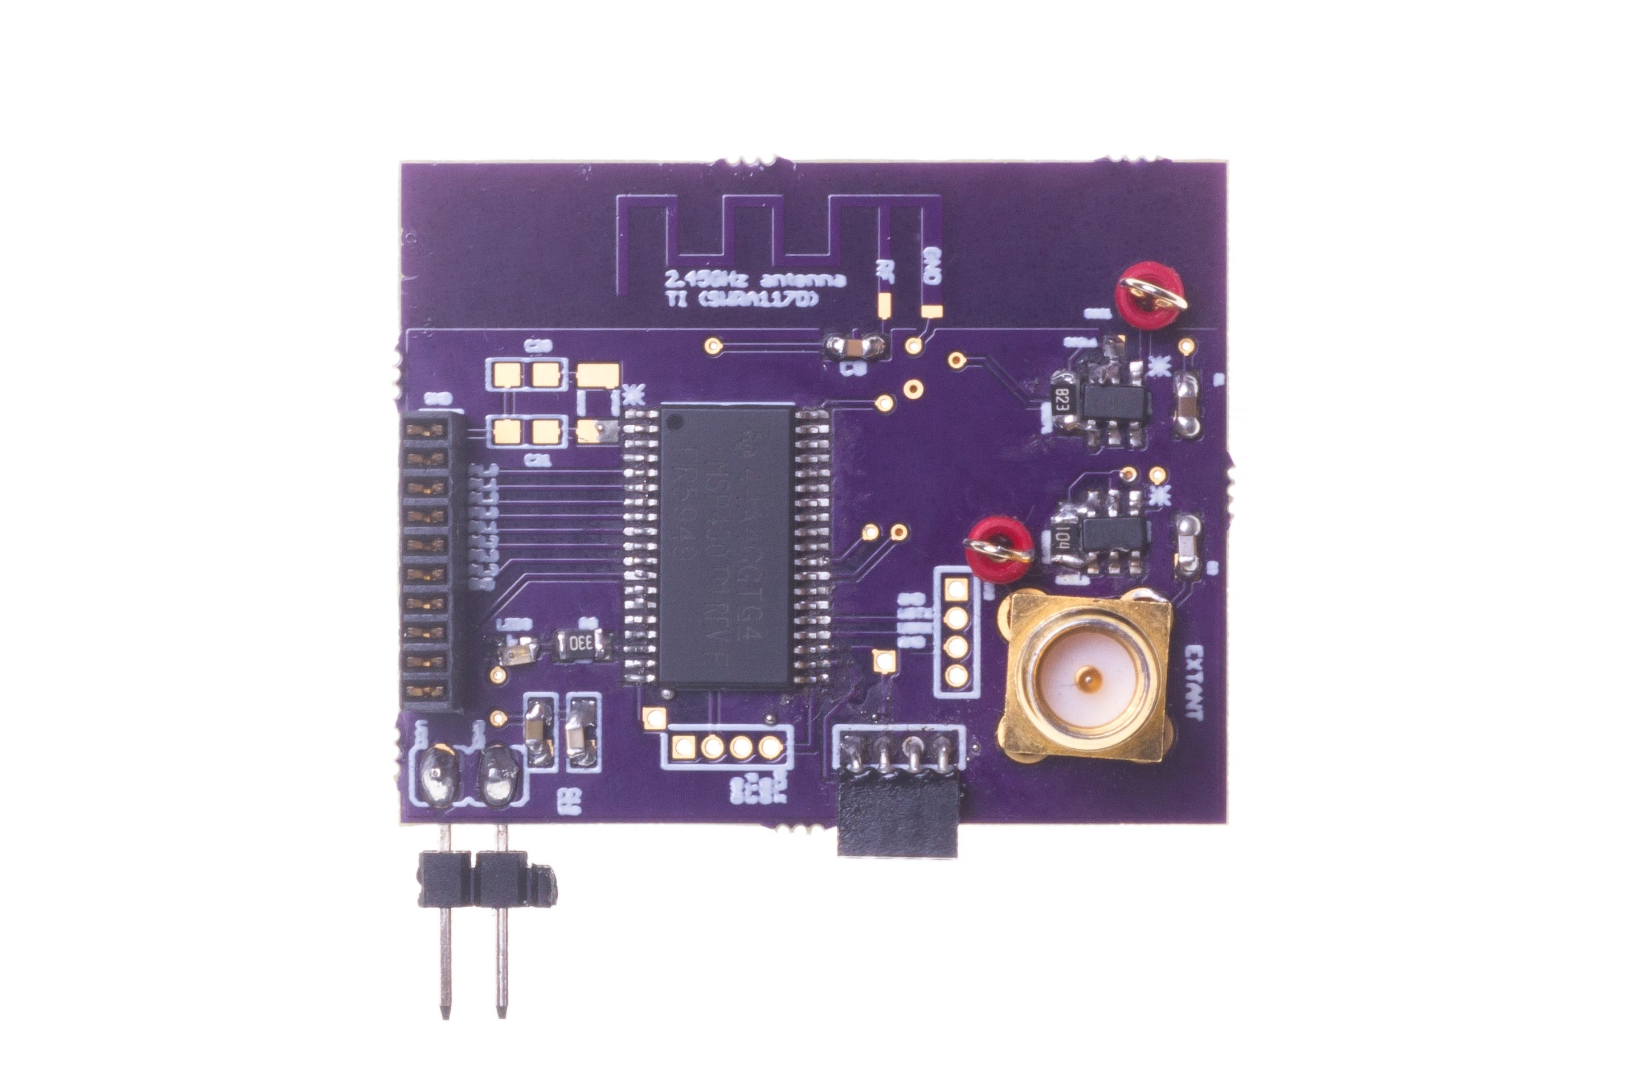
Long range backscatter transmissions using LoRea
LoRea is a long range, low-power, and low-cost backscatter architecture
System Overview
Backscatter Tag Hardware Prototype
(Peak Power of 70 µW)
Varshney et al. ”LoRea: A Backscatter architecture that achieves a long communication range” ACM SENSYS 2017
Notes:
+ Over the past several years, I have designed systems that overcome these critical limitations that have hindered the backscatter systems and have the prevented widespread adoption of the backscatter mechanisms on the Internet of Things devices. One of these systems is LoRea.
+ LoRea was presented at ACM SENSYS, which is a flagship conference in the area of embedded sensor systems. I show the architecture of LoRea on the left-hand figure on the slide. It consists of one or more commodity devices such as a smartphone or Wi-Fi router that provides the necessary carrier signal to support backscatter transmissions, a low-power backscatter tag that I had designed and transmit at a peak power of 70uw, and one or more receiver of backscatter transmissions.
+ The key highlight of LoRea was that it could achieve a significantly larger communication range than existing systems, was designed using off the shelf components and cost (few tens of USDs). Further, the backscatter tag could achieve this capability at orders of magnitude lower energy than commercially available radio transceivers.
+ How did LoRea achieve this capability? We would describe next.

Slide 39
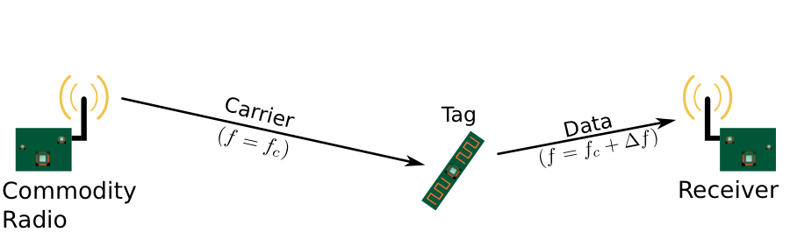
Design element #1: LoRea decouples the carrier signal generation and reception
Bi-static setup spatially separates carrier generation from the receiver
Use devices that surround us for providing the necessary carrier signal
Self-interference reduced due to path loss suffered by carrier signal
Monostatic configuration
Bi-static configuration
Notes:
+ If we look into a RFID reader's configuration, there is a single device that both receives the backscatter transmissions and generates the necessary carrier signal. This is called a monostatic configuration.
+ In LoRea, we decouple the task of carrier signal generation and the reception of the backscatter transmissions. We adopt a bistatic configuration as we show in the slide. We have a dedicated device for carrier signal generation and reception.
+The advantage of the bistatic configuration is two-fold: First, we can attenuate the carrier signal arriving at the receiver due to the path loss suffered due to the propagation of the wireless signal. This helps us reduce interference from stronger carrier signal to much weaker backscatter transmission. Second, it also enables us to use the devices that surround us, such as smartphones or wifi router, as sources for providing the necessary carrier signal to support backscatter transmissions. In fact, in lorea, we demonstrate the use of these devices to provide the carrier signal.’

Slide 40
Design element #2: LoRea backscatters at a frequency offset from the carrier signal
Backscatter is a mixing process
Transceivers attenuate interference at adjacent frequency channels
Frequency separation reduces interference from carrier to backscatter signal
No complex self-interference mechanisms required at reader
Notes:
+ The second design element that we incorporate in the design of LoRea is that we create separation in frequency between the carrier signal and the reflected transmissions. We transmit the backscattered signal at a particular offset from the carrier signal. This is unlike systems such as RFIDs that transmit at the same frequency as the carrier signal, requiring complex and expensive self-interference cancellation mechanisms.
+ To backscatter at an offset from the carrier signal, we take advantage of the property that the backscatter is a mixing process. If a carrier signal is incident on the backscatter tag, and if we toggle the antenna, i.e., change the antenna's state between absorption and reflection state at a frequency delta f, we can now create backscatter transmissions at a frequency offset of Fc+delta F due to the mixing property.
+ Most modern radio transceivers have bandpass filters present in adjacent frequency bands. They support these to enable co-existence on the shared wireless spectrum to suppress interference from adjacent traffic. We use these filters to our advantage; we place the carrier signal in the bandpass filter and significantly attenuate the carrier signal.
+ By incorporating the decoupling in space and frequency, we can reduce the interference to the weak backscatter transmissions from stronger carrier signal by up to 50-70 dB. We do not need to employ any complex self-interference cancellation mechanisms that are used on existing RFID readers. We use off-the-shelf commodity transceivers that just cost a few usd to carrier generation and the reception, thus significantly lowering the infrastructure's cost and complexity to support backscatter transmissions.

Slide 41
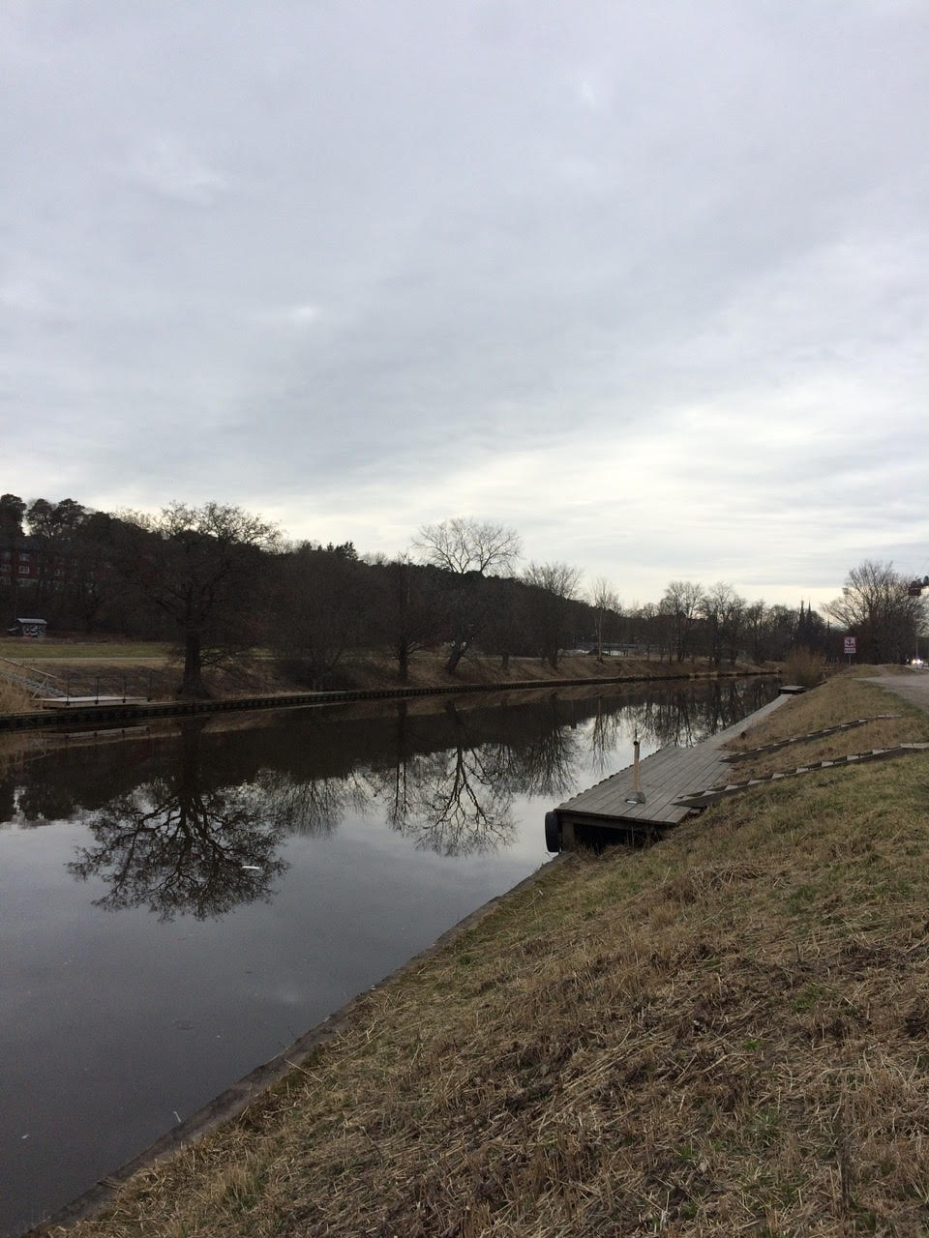
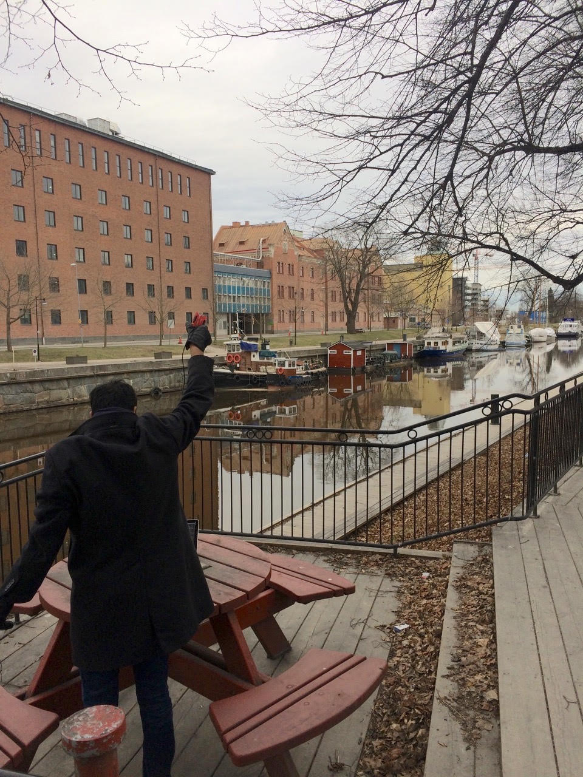
We ran out of space while performing experiments
State-of-art few meters. We achieved kilometers, was difficult to anticipate
Initial experiments conducted near the university and a river in Uppsala
Experiment Setup
Receiving transmissions 1km away from the setup

Slide 42
LoRea outperforms state-of-the-art systems
System name | Communication range
LoRea – 868 MHz (SENSYS 2017) | 3400 m
LoRea – 2.4 GHz (SENSYS 2017) | 225 m
RFID | < 18 m
BackFi (SIGCOMM 2015) | 5 m
Passive WiFi (NSDI 2016) | 30 m
HitchHike (SENSYS 2016) | 54 m
Interscatter (SIGCOMM 2016) | 30 m
LoRa Backscatter (UBICOMP 2017) | 2800 m
Range reported are line of sight, with backscatter tag co-located with carrier source

Slide 43
We ran out of space while performing experiments
State-of-art few meters. We achieved kilometers, was difficult to anticipate
Initial experiments conducted near the university and a river in Uppsala
Experiment Setup
Receiving transmissions 1km away from the setup
Notes:
Incorporating these three design elements, allows us to significantly push the communication range of the system. Next, we did experiments to investigate the transmission range that we can support with our system.
Performing these experiments was challenging as when we were designing LoRea the state of the art backscatter systems achieved a communication range of tens of meters. Hence, it was difficult to anticipate space required to perform these experiments.
We conducted the first experiment in the university, and we ran out the space, next we took the experiment setup next to a river in Uppsala. I show the setup on left hand side image, and on the right is picture of me capturing transmissions one kilometer away. However, while we were able to receive transmissions at fairly high SNR, we again ran out of space due to large range that we could achieve.

Slide 44
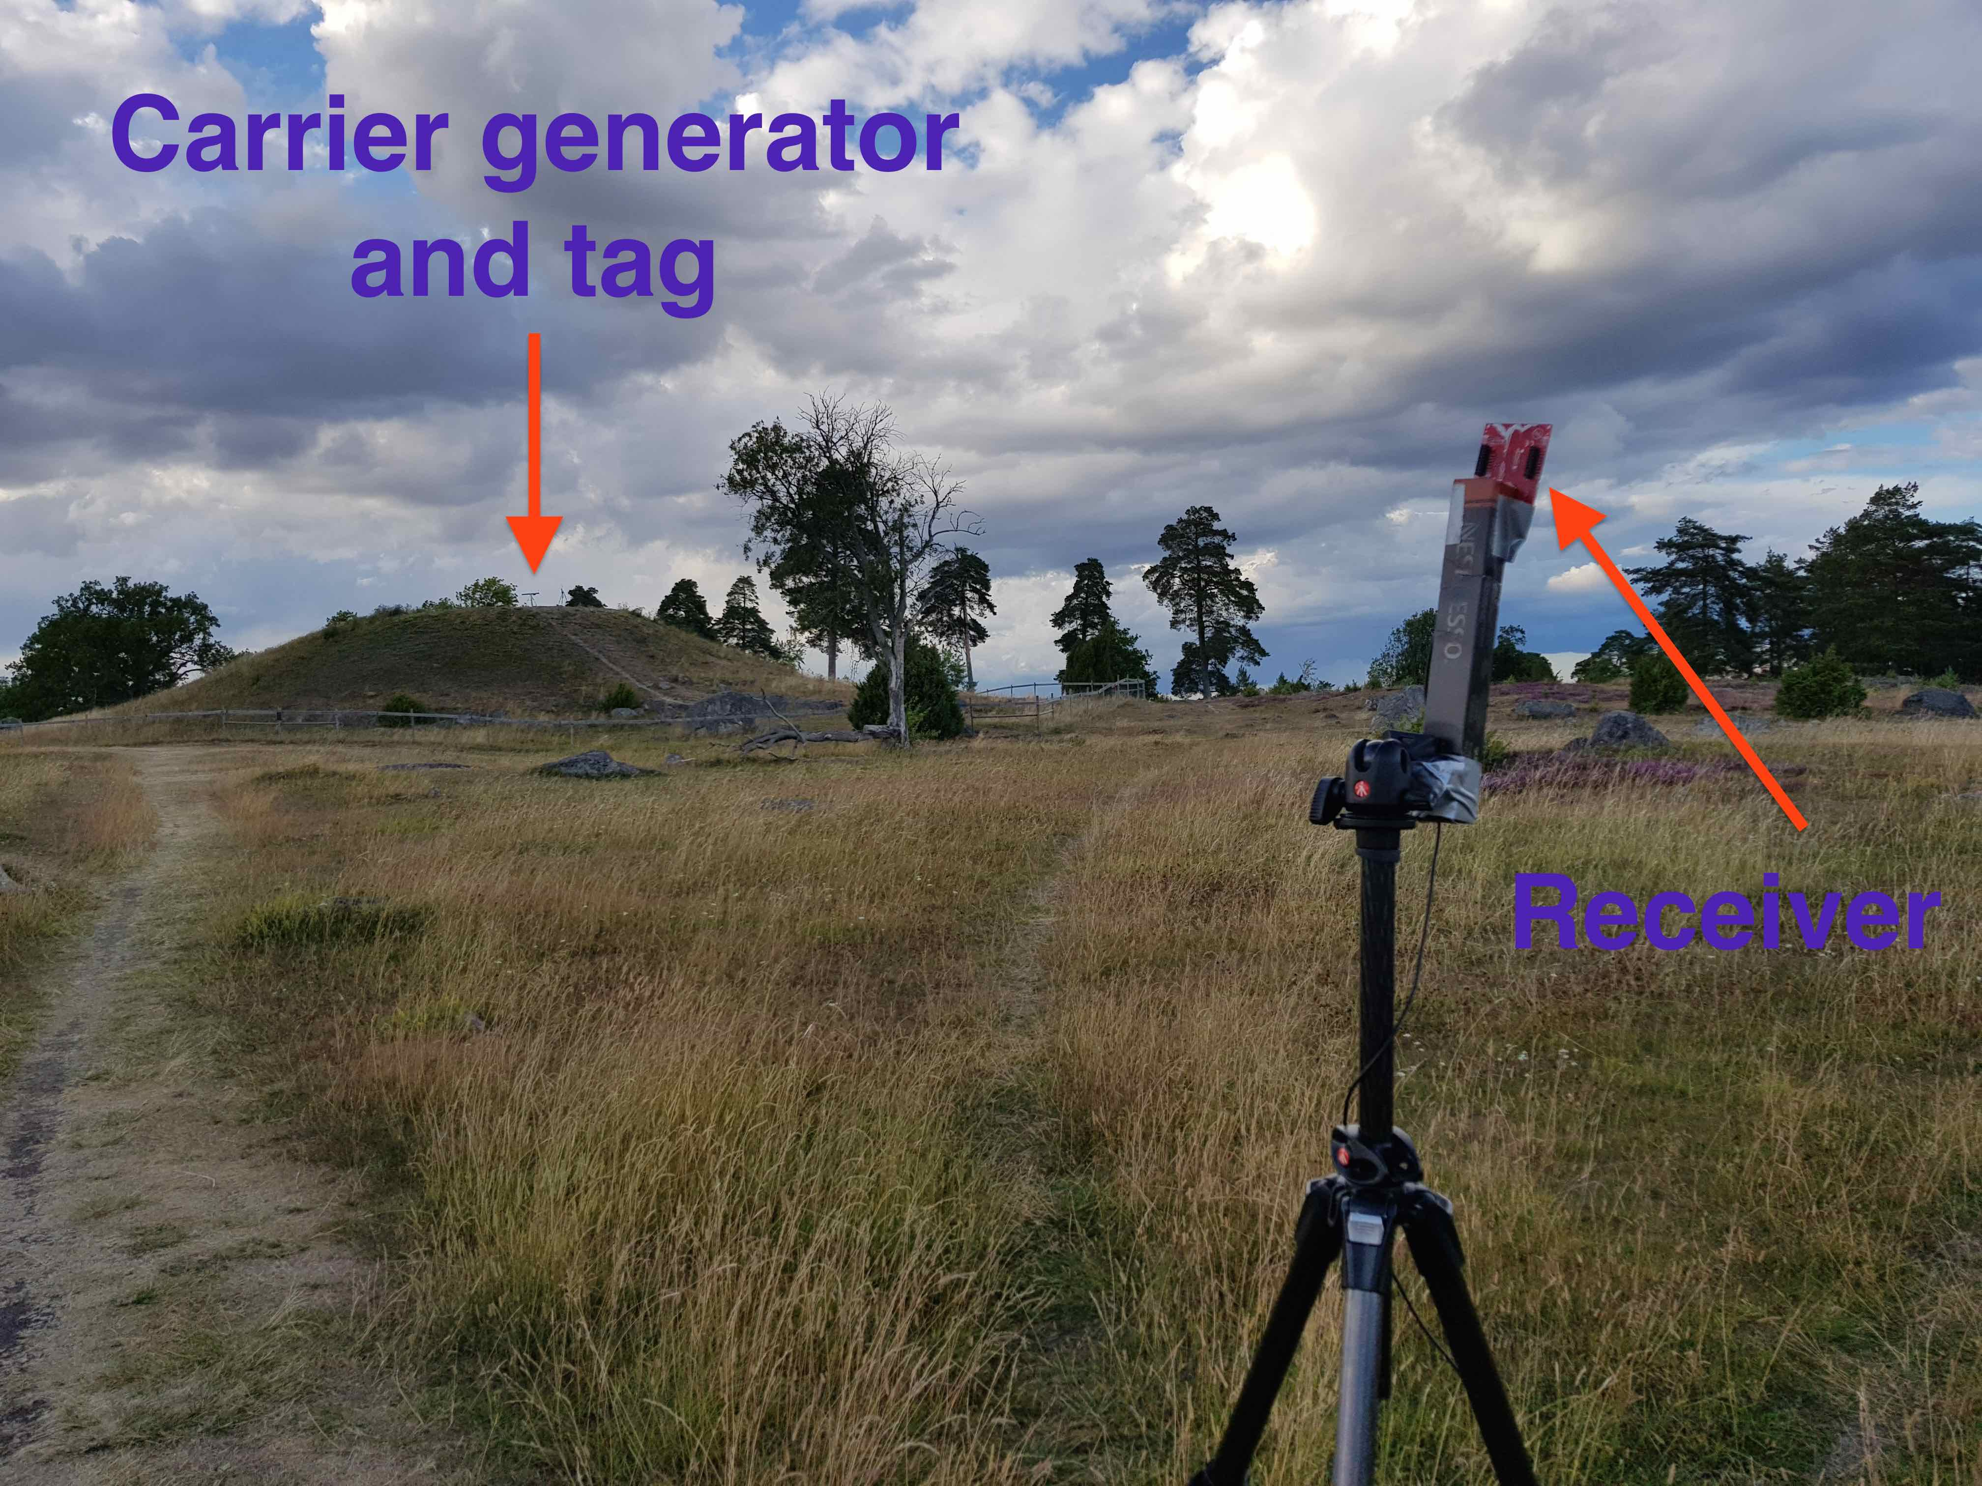
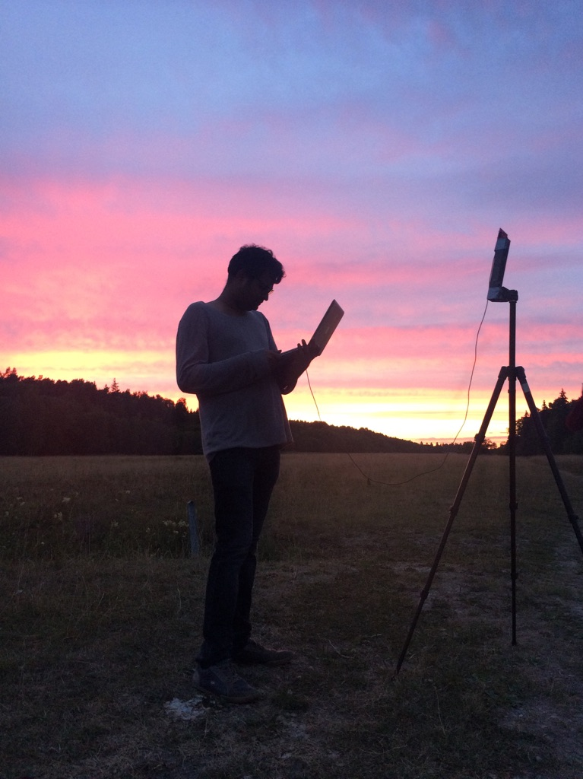

LoRea achieved the highest demonstrated range
Receive up to a distance of 3.4 kilometers from tag
Highest demonstrated range. Outperforms leading labs/universities
Experiment Setup
(On a small hill)
Receiving backscatter transmissions kilometers away from setup
Experiment setup video
Notes:
Hence, to find the maximum range we could achieve with our system, we took the entire setup outside Uppsala to an open space. We kept the backscatter setup on top of a small hill, and investigated the maximum communication range that we could support.
Performing these experiments was significantly challenging, as we would setup experiment in the daytime, and by the time we would finish collecting the link metrics, it would be dawn. We also had to walk significant distances with equipment.
We found that we could communicate up to a distance of 3.4 km while consuming tens of microwatts of power for wireless transmissions at the backscatter tag. Achieving such high communication range was considered challenging or even infeasible with backscatter mechanism, and LoRea helped overturn notion that backscatter is a low range transmission mechanism.

Slide 45
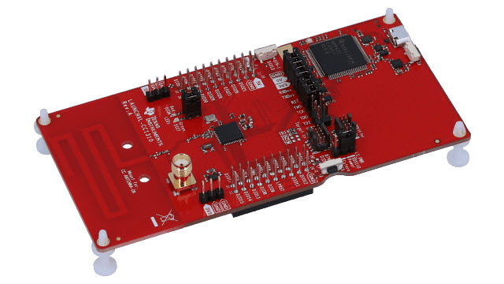
LoRea bridges the energy asymmetry between communication (TX), sensing and processing
Off-the-shelf hardware for transmission and receptions. Tens of USD
Overturn notion that backscatter is a short-range transmission mechanism
Component | Power Consumption
LoRea (Transmissions) | 70 µW (868 MHz)
Conventional Transceiver | Tens to hundreds of mW’s
Microcontroller (Apollo3) | 100s of µW’s
Sensors | Few to tens of µW’s
LoRea transmits at similar power consumption as a sensor
Texas Instruments CC1310 Launchpad: Receiver
Backscatter Tag Hardware Prototype
(Peak Power of 70 µW)
Notes:
+ Thus, with LoRea, we were able to design a backscatter system that was able to overcome the range and cost limitations that had limited all the existing backscatter system, and had hindered the widespread usage of the mechanism on the IoT devices
.
+ In fact, the backscatter tag even though it was designed using off-the-shelf components is orders of magnitude more efficient than commercial transceivers while supporting orders of magnitude lower power consumption.
+ the entire backscatter setup costs just few tens of USDs, which dramatically lowers the cost of infrastructure required to support the backscatter tags and carrier emitter device.

Slide 46
Let’s look at the battery-life again
Notes:
++ Over the past few years, I have designed several backscatter and beyond backscatter systems that precisely overcome these critical challenges that have limited the widespread deployment of backscatter on IoT devices.
++ The research vision that I have pursued and would like to pursue as a faculty member is to enable a massive deployment of IoT devices by bridging the energy asymmetry between sensing, computation and communication blocks by designing novel platforms and communication mechanisms. I am going to describe some of my research contributions next.

Slide 47
What is the expected lifespan of a battery?
Coin cell (CR2032): 240 mAh, Flexible battery (Molex): 10 mAh
Backscatter transmitter: (LoRea, SENSYS 2017) – 35 uA
Let’s estimate long would battery last under different device load:
Component | Current draw | Flexible Battery | Coin cell
Microcontroller | 200 uA | 50 h | 1200 h
Accelerometer | 10 uA | 1000 h | 24000
WiFi Transmitter | 15 mA | 45 mins | 16 h
Bluetooth Transmitter | 1 mA | 10 h | 240 h
Backscatter Transmitter | 35 uA | 285.7 h | 6857 h

Slide 48

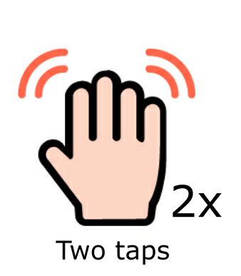
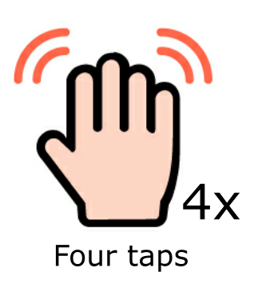
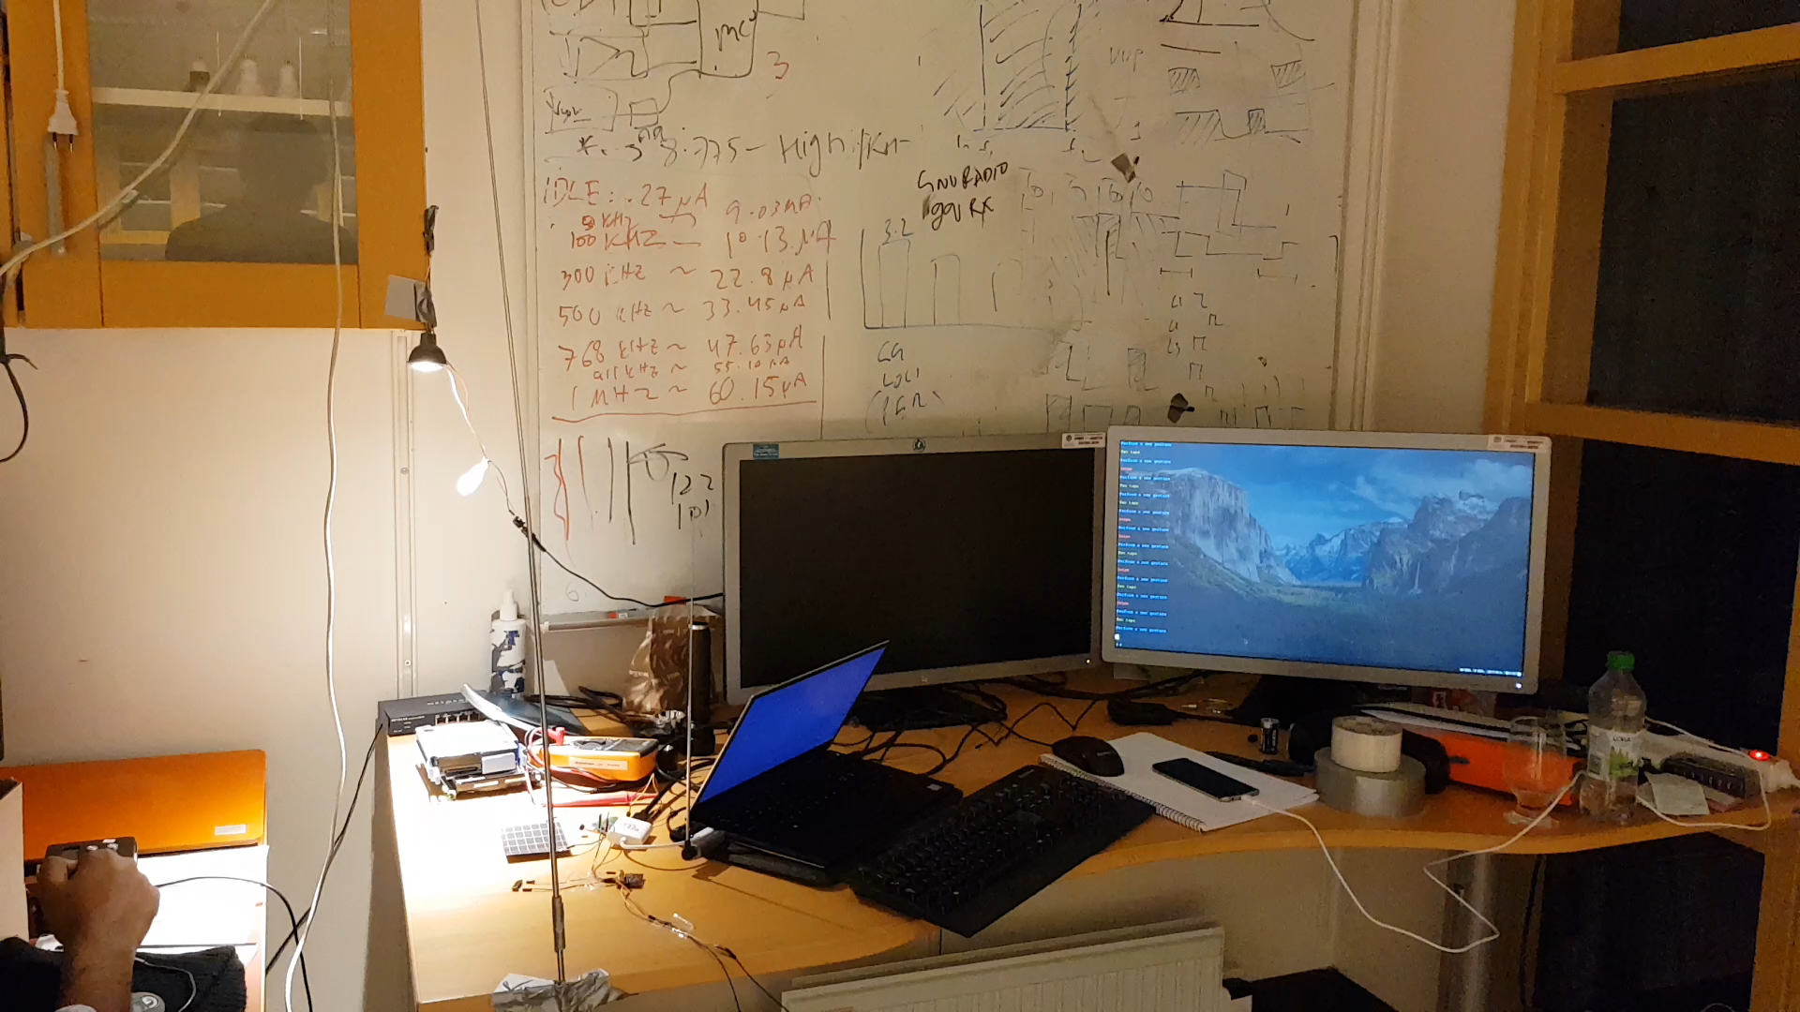
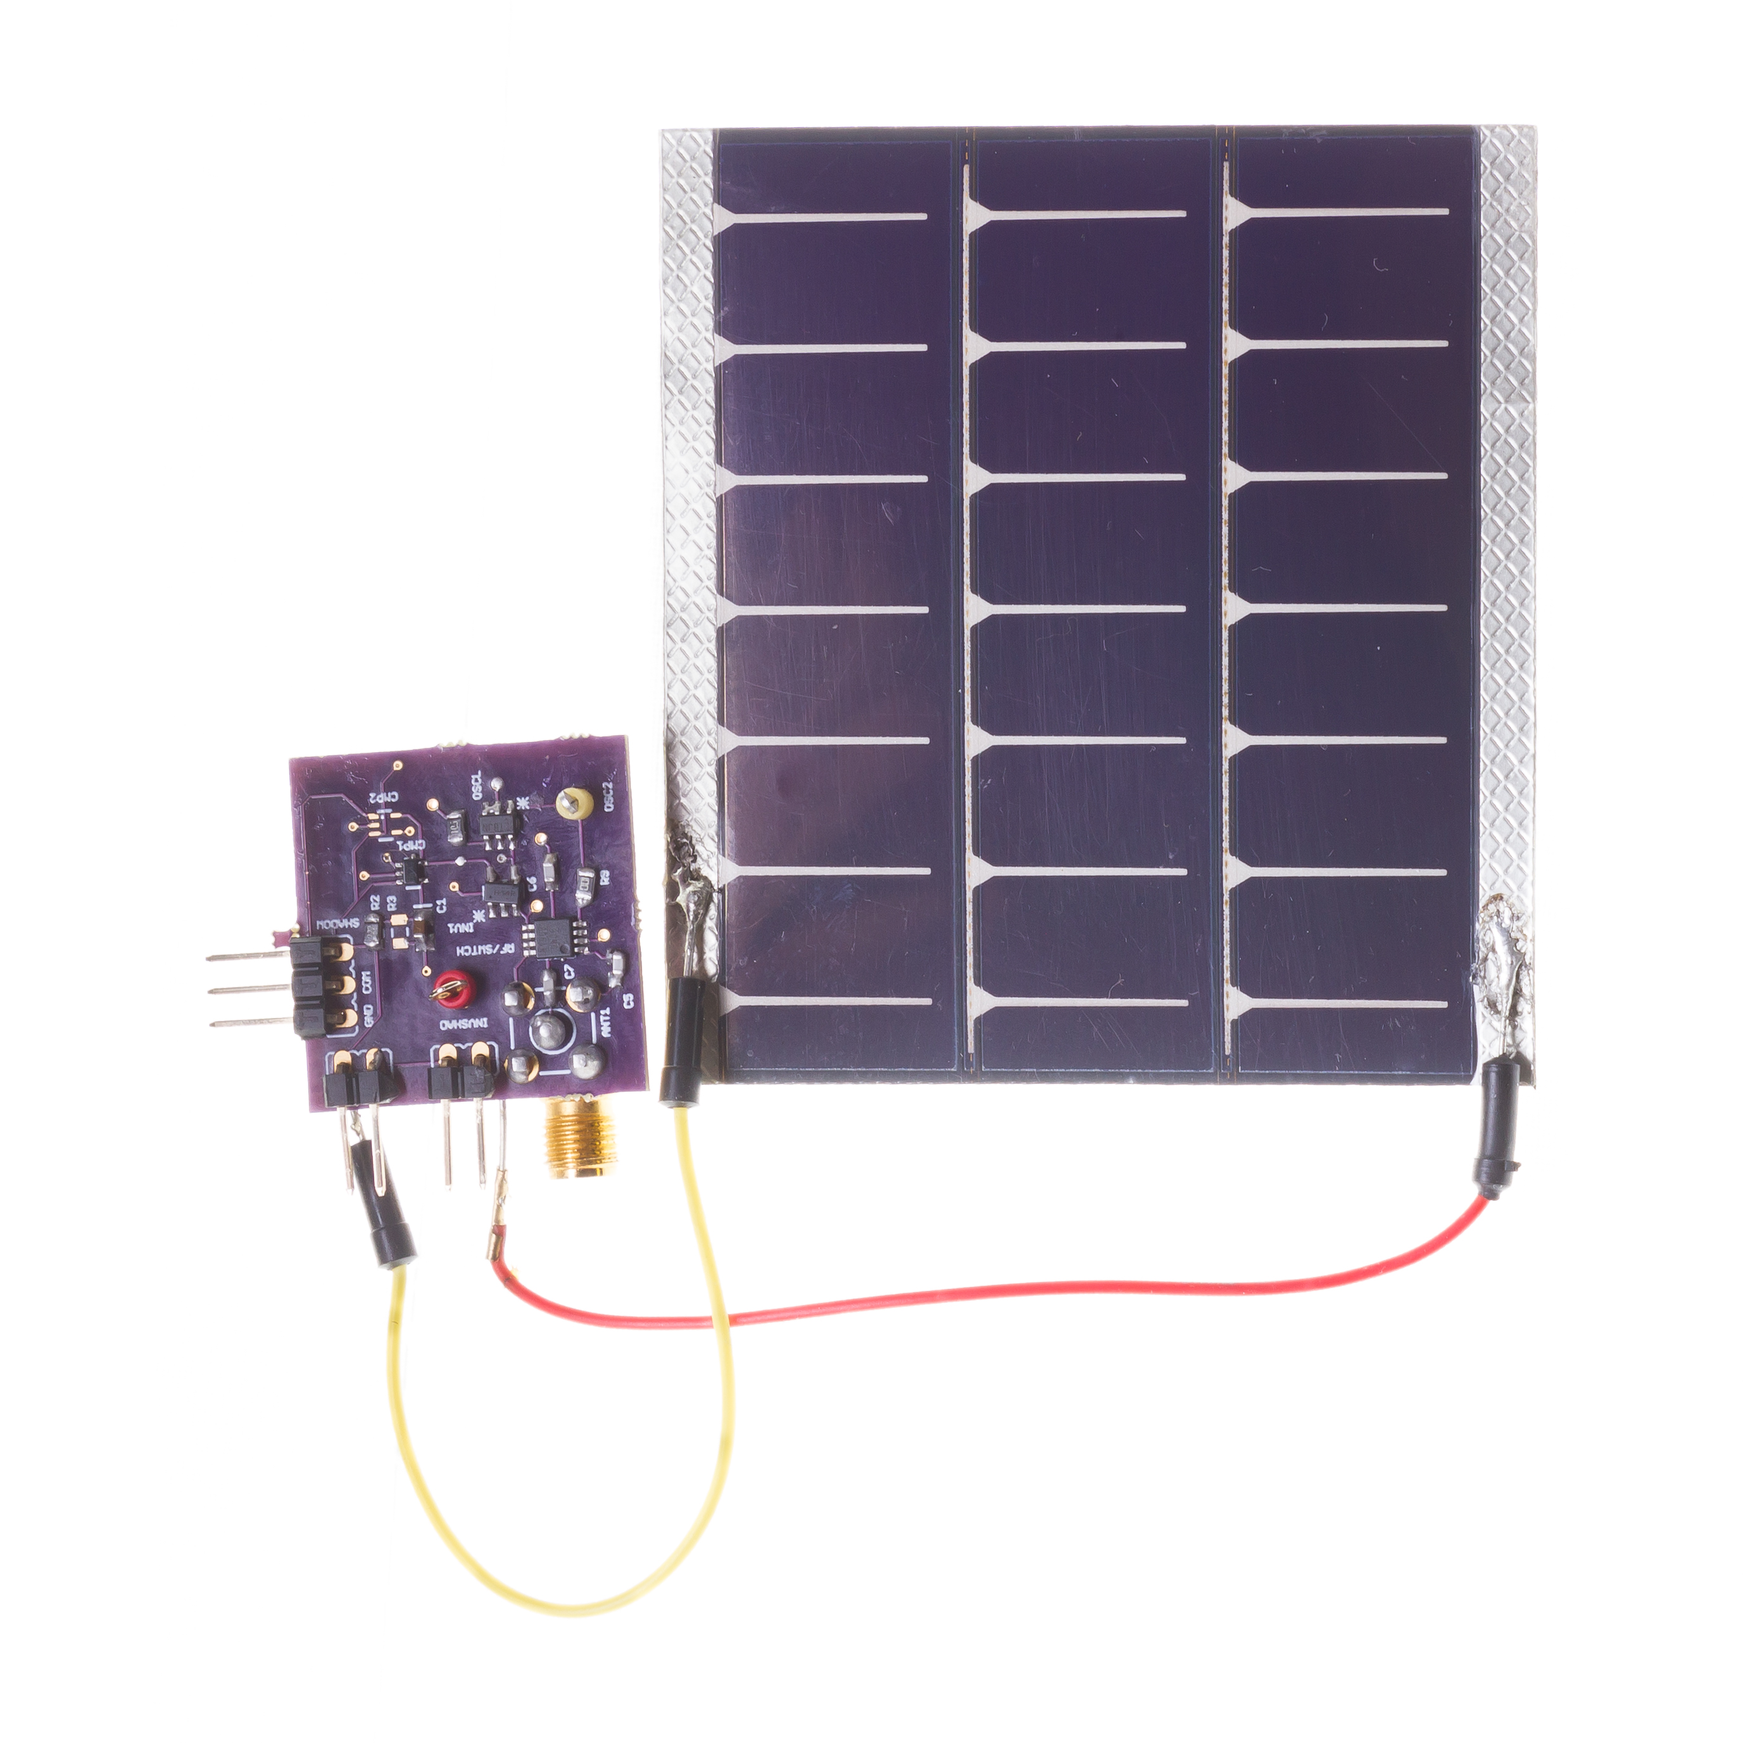
Battery-free Visible Light Sensing
Hardware Prototype
Gesture Sensing Demonstration
(Transmit by reflecting ambient FM signals)
Varshney et al. “Battery-free Visible Light Sensing” ACM VLCS 2017 (Best Paper)
Notes:
+ As an example, in this slide, I demonstrate one of the projects that I had designed together with my mentored student (Andreas). We demonstrate the world’s first battery-free ight sensing system.
+ We designed a light sensor that could track light levels and communicate by the reflections of the ambient fm signal, all while supporting operation on the energy harvested from small credit card sized solar cell. We show the hardware prototype that we had designed on the right hand side. We could perform light sensing, and communication at peak power of 20 uW, which is many orders of magnitude lower than what your smartphone or other wireelss devices in your home consume.
+ In this video, we perform hand gestures, which causes unique changes in the light intensity, and we transmit these light readings to a computer. Through a classifier running on the computer we could detect the gestures that were performed.

Slide 49
Let’s look at the battery-life again
Notes:
++ Over the past few years, I have designed several backscatter and beyond backscatter systems that precisely overcome these critical challenges that have limited the widespread deployment of backscatter on IoT devices.
++ The research vision that I have pursued and would like to pursue as a faculty member is to enable a massive deployment of IoT devices by bridging the energy asymmetry between sensing, computation and communication blocks by designing novel platforms and communication mechanisms. I am going to describe some of my research contributions next.

Slide 50
What is the expected lifespan of a battery?
Coin cell (CR2032): 240 mAh, Flexible battery (Molex): 10 mAh
Backscatter transmitter: (LoRea, SENSYS 2017) – 35 uA
Let’s estimate long would battery last under different device load:
Component | Current draw | Flexible Battery | Coin cell
Microcontroller | 200 uA | 50 h | 1200 h
Accelerometer | 10 uA | 1000 h | 24000
WiFi Transmitter | 15 mA | 45 mins | 16 h
Bluetooth Transmitter | 1 mA | 10 h | 240 h
Backscatter Transmitter | 35 uA | 285.7 h | 6857 h

Slide 51
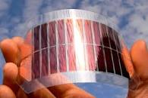
What's next? Embedded systems on harvested energy
𝜇W
Energy harvester
Microwatts of power available to harvest from ambient sources
Notes:
++ The high-power consumption for the IoT platforms also blocks an important and promising direction to enable the sustainable deployment of large-scale embedded devices. This is to eliminate batteries from these platforms altogether. If we eliminate batteries, how do we power these devices?
++We use the fact that ambient energy sources surround us. We are constantly bombarded with radio frequency transmissions such as television, wifi, radio signals, or we have waste heat energy sources, or the indoor light is ubiquitous. All these sources could be harvested to derive energy to power the IoT devices and platforms and eliminate the overhead associated with batteries on these platforms. However, the challenge that we encounter is that we could only derive microwatts of power from these ambient sources, which is sufficient to power the sensors and microcontrollers. However, we need orders of magnitude higher power for operating radio transceivers such as LoRa. This makes it challenging, if not impossible, to power sensors through energy derived from the environment.

Slide 52
Embedded systems on harvested energy
Batteries/Capacitors can potentially be recharged by environmental effects
Some examples
Solar : solar cell
Wind: micro wind turbine can be used to harvest wind energy readily available in the environment in the form of kinetic
Thermal: capture energy from industrial equipment, structures, and even the human body.
Vibration: vibration from engines can stimulate piezoelectric materials, as can the heel of a shoe.
Kinetic: translate movement to change in electromagnetic flux
Radio Frequency (RF): convert ambient RF signal into energy (demo video)

Slide 53
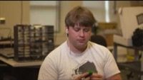
Demo: Battery-free Cellphone
Courtesy: University of Washington, Seattle
Battery-free Cellphone, IMWUT/UBICOMP 2018

Slide 54
Backscatter Like Transmission Mechanisms
Notes:
++ Over the past few years, I have designed several backscatter and beyond backscatter systems that precisely overcome these critical challenges that have limited the widespread deployment of backscatter on IoT devices.
++ The research vision that I have pursued and would like to pursue as a faculty member is to enable a massive deployment of IoT devices by bridging the energy asymmetry between sensing, computation and communication blocks by designing novel platforms and communication mechanisms. I am going to describe some of my research contributions next.

Slide 55
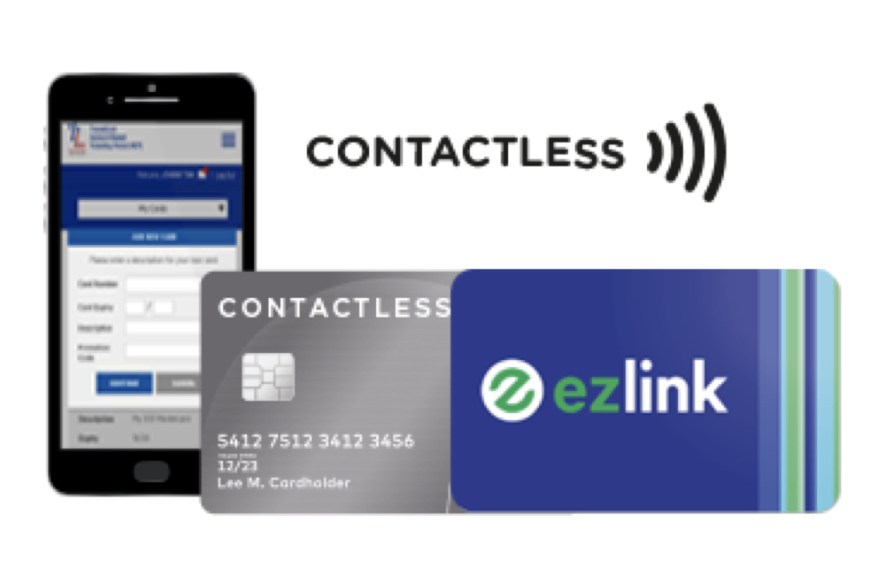
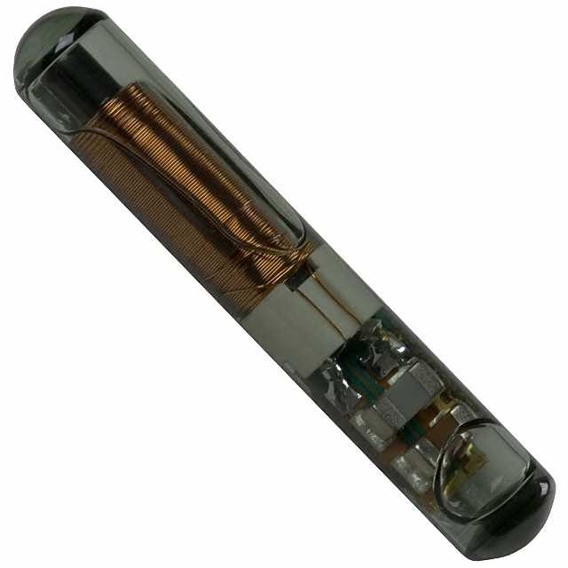
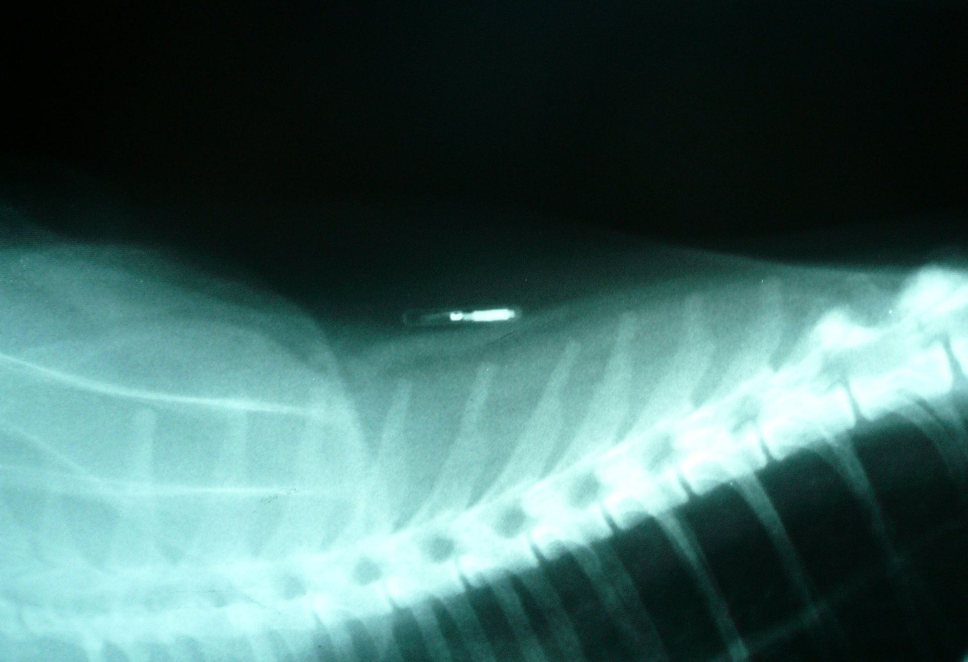
What communication modality do these use?

Slide 56
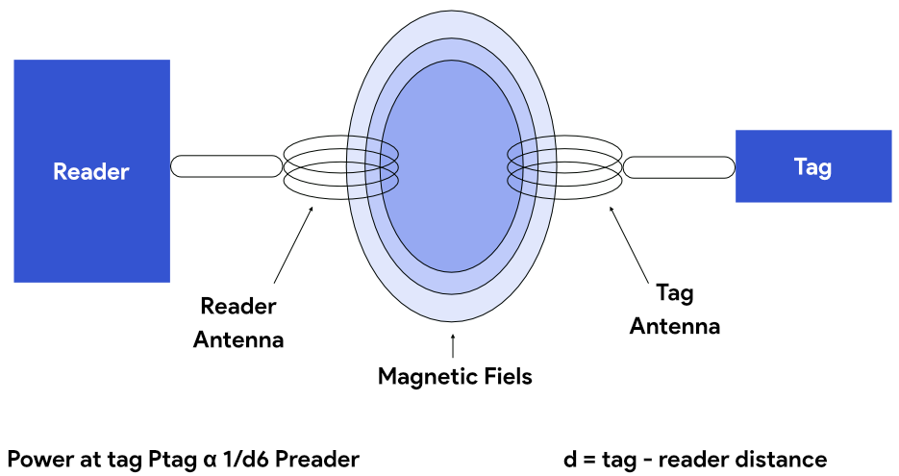
Communication using inductive coupling
A shared magnetic field is created between the two devices
Change in current through one device induces current change through the other
Device can vary load to transmit data
Very low frequency bands (135 KHz, 13.56 MHz)
Transmit through materials including skin
Sensitive to metal

Slide 57
Near Field Communication (NFC)
Inductive Coupling concept (13.56 MHz)
But attached to a powered and capable device (smartphone)
10-20 cm range max (usually <10)
Can act as a tag or as a reader
Allows smartphone to power a tag if needed
Alternatively, smartphone could act like a card and respond to a reader
Two smartphones can communicate without power transfer
Data rate 100-400 kbps!
nRF52840 capable of 100 kbps communication with attached antenna

Slide 58
Wireless communication using Light?
Notes:
++ Over the past few years, I have designed several backscatter and beyond backscatter systems that precisely overcome these critical challenges that have limited the widespread deployment of backscatter on IoT devices.
++ The research vision that I have pursued and would like to pursue as a faculty member is to enable a massive deployment of IoT devices by bridging the energy asymmetry between sensing, computation and communication blocks by designing novel platforms and communication mechanisms. I am going to describe some of my research contributions next.

Slide 59
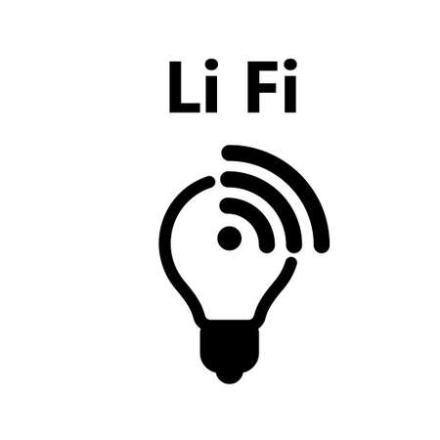

Light Fidelity (LiFi) for Internet of Things
00100111
0
0
1
1
0
0
1
Light-fidelity
1
Advantages:
Illumination
Energy
Communication
Notes:
Let’s start the background story from LiFi
Light fidelity is a wireless technology that uses visible light for data transmission. The information is modulated on the light signal according to the baseband signal.
LiFi offers advantages, such as using a different part of the specturm other than crowded RF electromagnetic signal
In addtion, it simultaneously provide, illumination, energy and communication
Which makes it a good candidate for IoT connectivity.

Slide 60

LiFi communication suffers from coverage challenges
Light cannot propagate through walls or other such physical boundaries
Great from privacy perspective, but limits deployable location of IoT devices
Many IoT devices are located in places with very poor light propagation
IoT devices that are located in the air vents
Inside the wall, floor and other surfaces
IoT devices that are embedded inside the human body
Notes:
Light signal can not propagate through physical spaces. Things like walls, floors, metals block light signal.
When considering privacy, this is an advantage. However for IoT applications, it limits the scenarios where sensors located in places with poor light propagation.

Slide 61
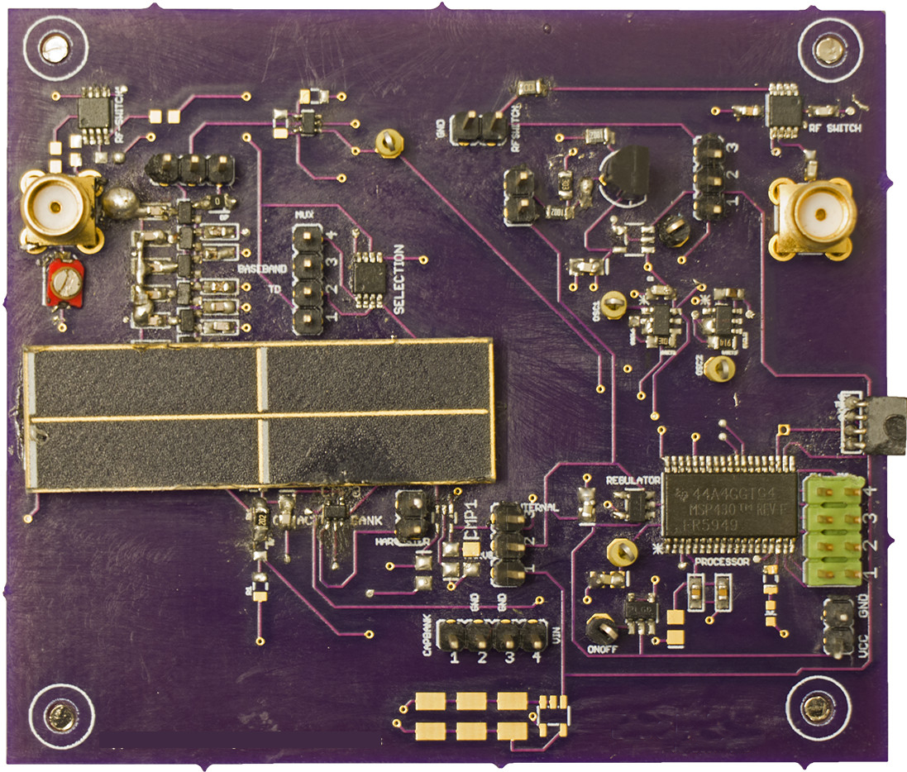
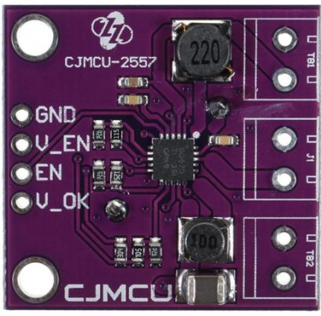
EDISON : Communication through visible light
Backscatter modulator
LiFi Front-end
MCU
Power management
Galliesto et al. ” Two to tango hybrid light and backscatter networks for next billion devices” ACM MOBISYS 2020
(co-primary author with me)
Notes:
External power management for convenience

Slide 62
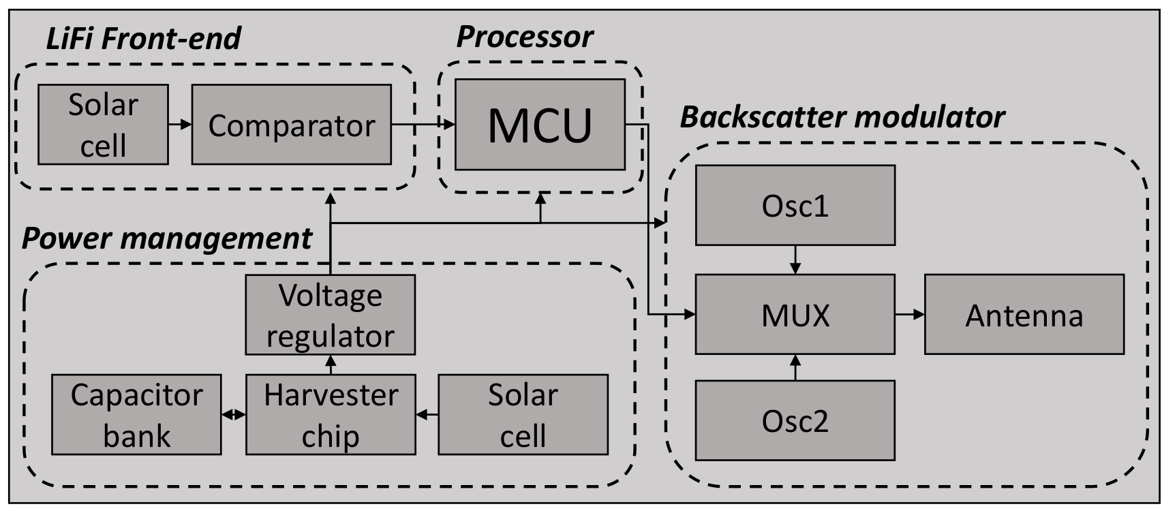
Energy flow within the EDISON tag
Notes:
Only power management

Slide 63
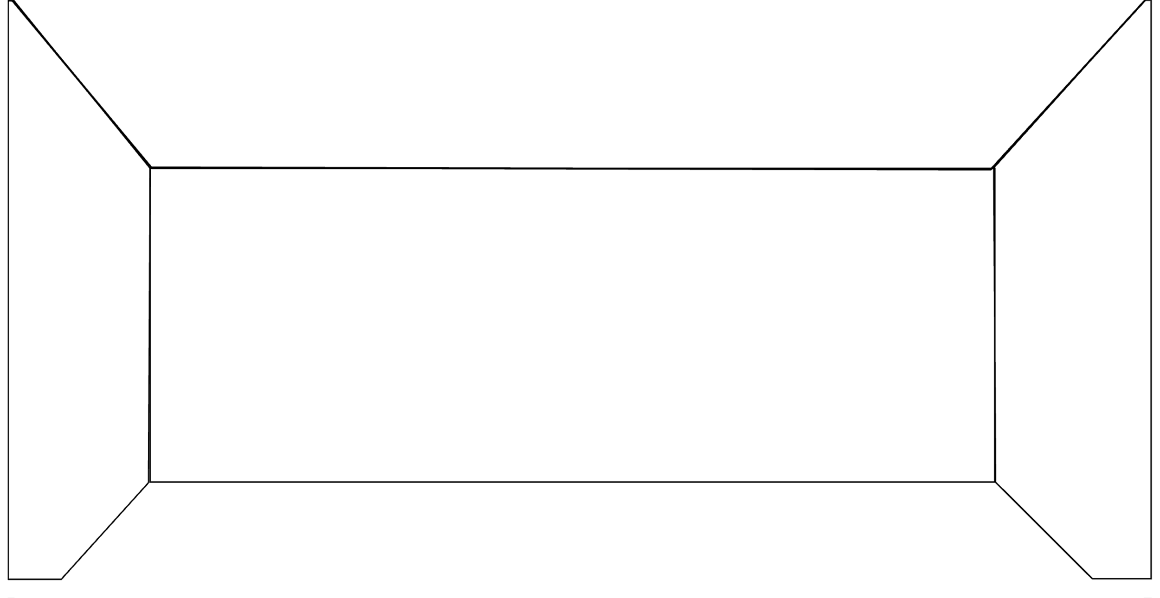


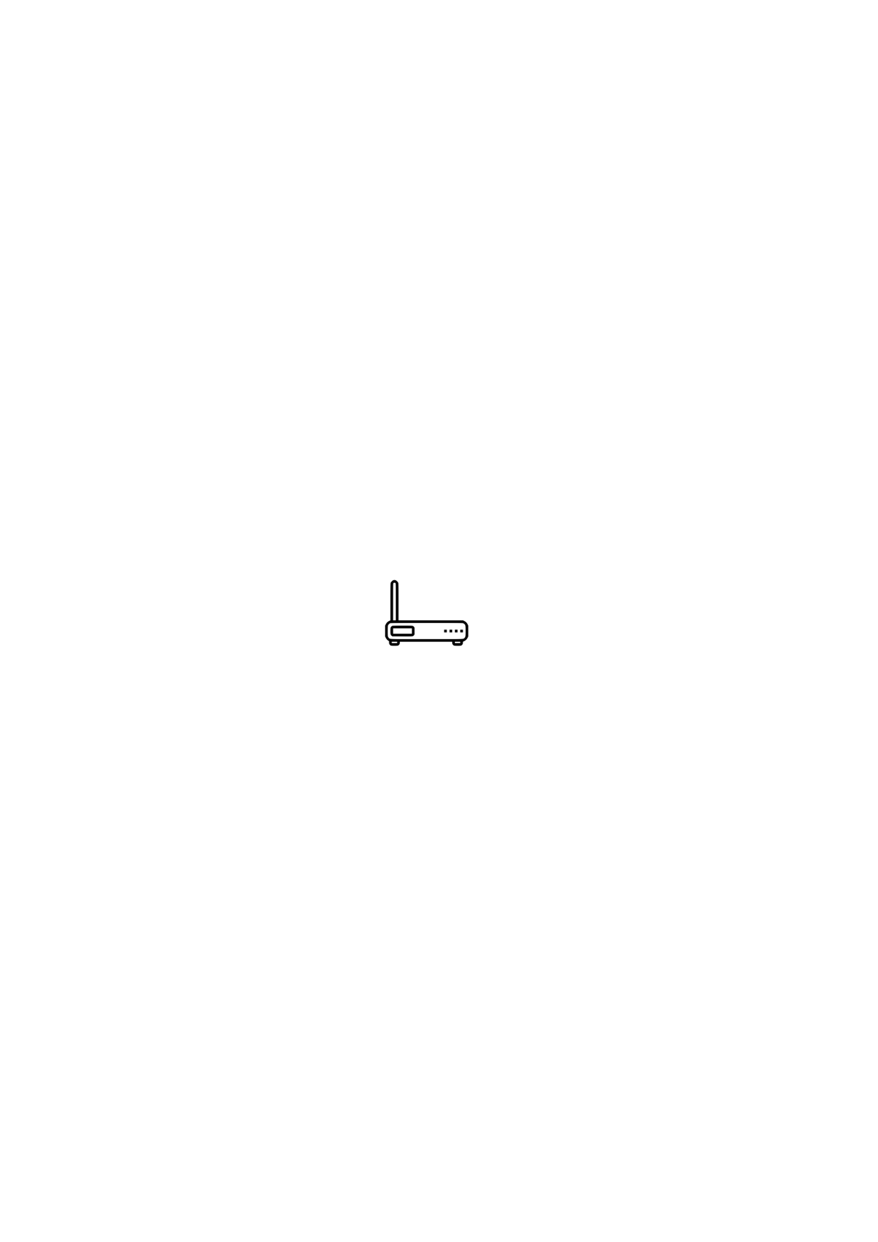

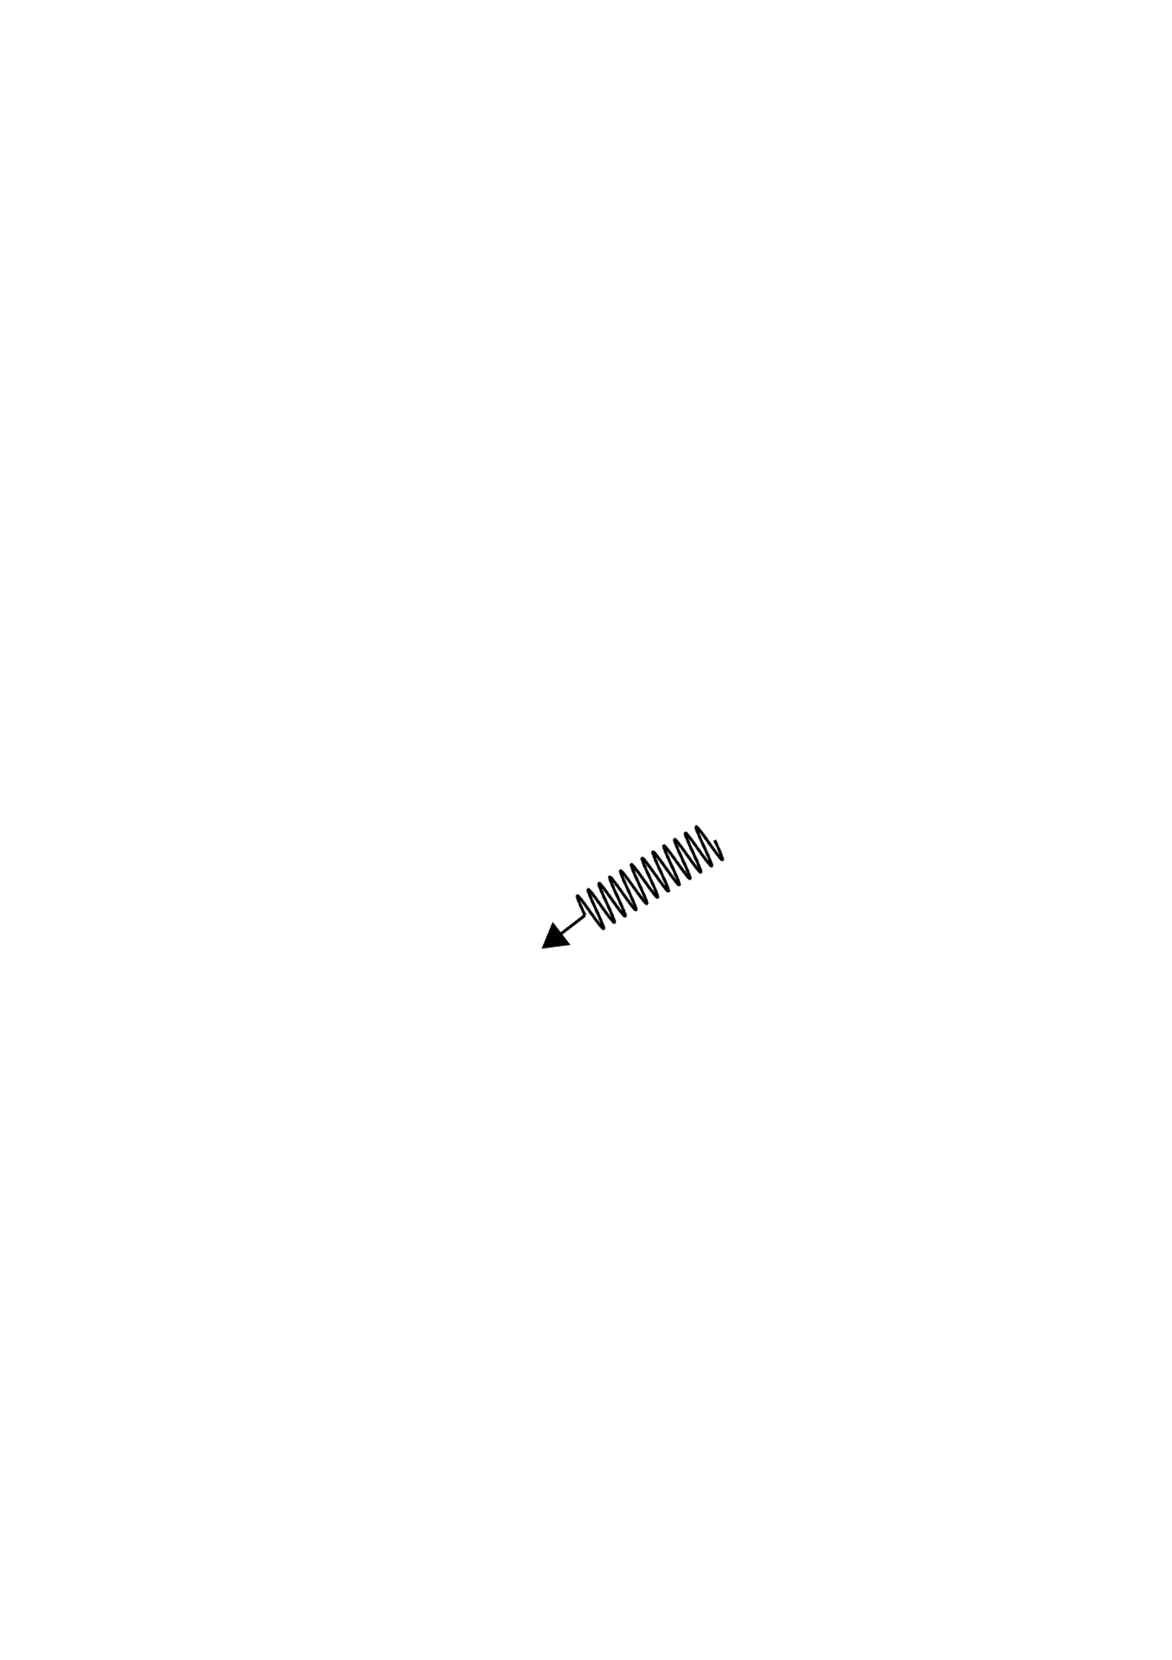
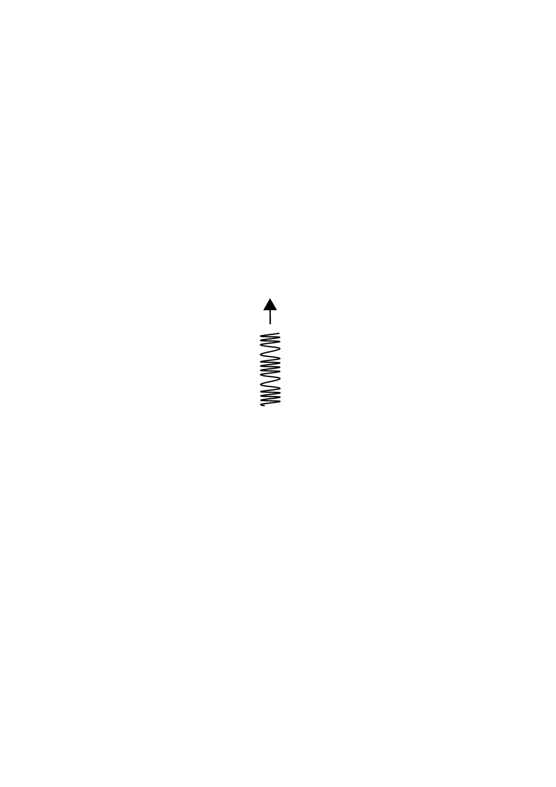

Overview of the Edison system
Lighting Network
0
1100
1
0
0
11
RF Carrier
RF Router
(edge device)
RF Backscatter
Battery-free device
Notes:
obvious

Slide 64
Roadmap of the lecture today
Let us recall what was covered in the last lecture
Energy consumption calculation
Low-power wireless transmissions using backscatter mechanism
Backscatter like mechanism and LiFi
Communication layers and medium access control
Notes:
Here is the roadmap of the major topics that I am going to cover during the presentation. We have already covered the exponential growth of the internet of things; next, I will talk about the critical energy challenge that can severely hinder this massive growth and preventing us from realising this immense economic value enabled by the IoT.

Slide 65
Communication Layers
Notes:
++ Over the past few years, I have designed several backscatter and beyond backscatter systems that precisely overcome these critical challenges that have limited the widespread deployment of backscatter on IoT devices.
++ The research vision that I have pursued and would like to pursue as a faculty member is to enable a massive deployment of IoT devices by bridging the energy asymmetry between sensing, computation and communication blocks by designing novel platforms and communication mechanisms. I am going to describe some of my research contributions next.

Slide 66
What are the various communication layers?
Application
Presentation
Session
Transport
Network
Data Link
Physical

Slide 67
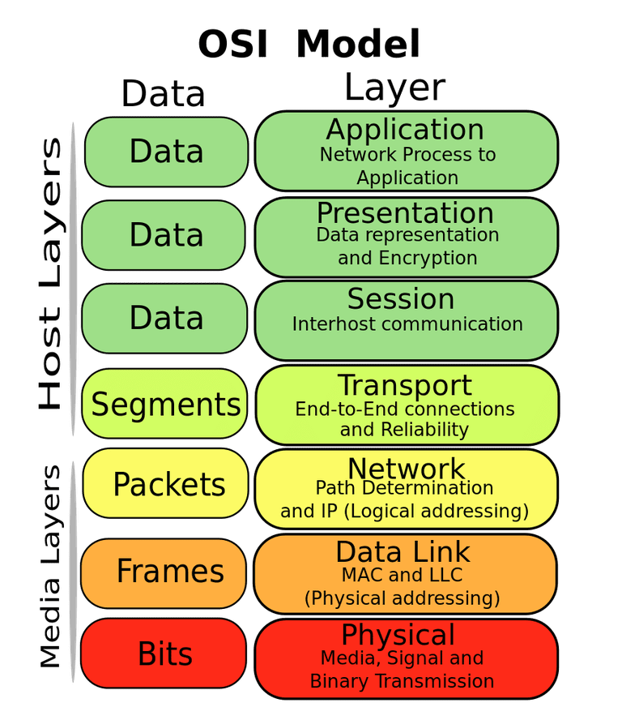
OSI model of communication layers
Transport
How to form connections between computers
TCP and UDP
Network
How to send packets between networks
IP
Data Link
How to send frames of data
Ethernet, WiFi
Physical
How to send individual bits
Ethernet, WiFi

Slide 68
Protocols are “layered”
Headers for each layer of communication wraps data
Data is wrapped with header for the network to make a packet
Packet is wrapped with header for the link to make a frame
Internet Packet
Data
Packet Header
Frame Header
Ethernet Frame

Slide 69
Data Link Layer
Framing
Combine arbitrary bits into a “packet” of data
Logical link control
Manage transfer between transmitter and receiver
Error detection and correction
Media access
Controlling which device gets to transmit next
Inherently coupled to PHY and its decisions

Slide 70
Framing
Typical packet structure
Preamble - Existence of packet and synchronization of clocks
Header - Addresses, Type, Length
Data - Payload plus higher layer headers (e.g. IP packet)
Trailer - Padding, CRC
Wireless considerations
Control information for Physical Layer
Ensure robustness for header
Explicit multi-hop routing
Possibly different data rates for different parts of packet
Preamble | Destination Address | Source Address | Type and Length | Data | CRC

Slide 71
Error control: detection and recovery
Detection: only detect errors
Make sure corrupted packets get discarded
Cyclical Redundancy Checks
Detect single bit errors
Detect “burst” errors of several contiguous bits
Recovery: also try to recover from small bit errors
Forward error correction
Retransmissions
Far more important for wireless because the cost of transmission is higher

Slide 72
Need for Medium Access Control
Notes:
++ Over the past few years, I have designed several backscatter and beyond backscatter systems that precisely overcome these critical challenges that have limited the widespread deployment of backscatter on IoT devices.
++ The research vision that I have pursued and would like to pursue as a faculty member is to enable a massive deployment of IoT devices by bridging the energy asymmetry between sensing, computation and communication blocks by designing novel platforms and communication mechanisms. I am going to describe some of my research contributions next.

Slide 73
What is hard about wireless?
There are no wires!
Wired networks are constant, reliable, and physically isolated
Ethernet has the same throughput minute-to-minute
Bits sent through Ethernet or USB are (usually) received
Wireless networks are variable, error-prone, and shared
WiFi throughput changes based on location and walls
Signals from nearby devices interfere with your signals
Individual bits might flip or never be heard at all

Slide 74
Wireless is a shared medium
Wired communication has signals confined to a conductor
Copper or fiber
Guides energy to destination
Protects signal from interference
Wireless communication is inherently broadcast in nature
Energy is distributed in space
Signals must compete with other signals in same frequency band

Slide 75
Increasing network capacity is challenging
Wired networks just add more wires
Buses are many signals in parallel to send more data
Wireless networks are harder
Adding more links increases interference
Need to expand to different frequencies

Slide 76
Analogy: wireless medium as acoustic
How do we determine who gets to speak?
Two simultaneous speakers also lose both “transmissions”
Eye contact (or raise hand) -> out-of-band communication
Wait until it’s quiet for some time -> carrier sense multiple access
Strict turn order -> time division multiple access
Just speak and hope it works -> ALOHA
Everybody sing at different tones -> frequency division multiple access (stretching the metaphor)

Slide 77
Wired vs. Wireless
Key difference between wired and wireless is the need to support multiple access as wireless is broadcast in nature
How does a network determine which transmitter gets to transmit?
Remember: the wireless medium is inherently broadcast
Two simultaneous transmitters may lose both packets

Slide 78
Wireless: What are challenges of multiple access
Problem: Multiple radio transmitters want to access a common channel
How to coordinate access for these radio transmitters ?

Slide 79
What are mechanisms for multiple access
Mechanisms to support multiple access:
Avoid or reduce collisions
Detect collisions (less common in existing wireless MAC)
Decide when to retransmit

Slide 80
Random access medium access control protocols
No coordination
The simplest: ALOHA
When a node needs to send, it does so.
If it hears an acknowledgment within a given duration, transmission is successful
otherwise, it resends after waiting a random amount of time.
Protocol strength
minimum overhear
achieves low delay if the load is light

Slide 81
ALOHA
ALOHAnet (1971)
University of Hawaii – Norman Abramson
First demonstration of wireless packet network
Rules
If you have data to send, send it
Two (or more) simultaneous transmissions will collide and be lost
Wait a duration of time for an acknowledgement
If transmission was lost, try sending again “later”
Want some kind of exponential backoff scheme here

Slide 82
Packet collisions
Each packet transmission has a window of vulnerability
Twice the on-air duration of a packet
Transmissions during the packet are bad
Transmissions before packet can also be bad

Slide 83
Slotted ALOHA
Split time into synchronized “slots”
Any device can transmit whenever it has data
But it must transmit at the start of a slot
And its transmission cannot be longer than a slot
Removes half of the possibilities for collisions!
At the cost of some synchronization method
time

Slide 84
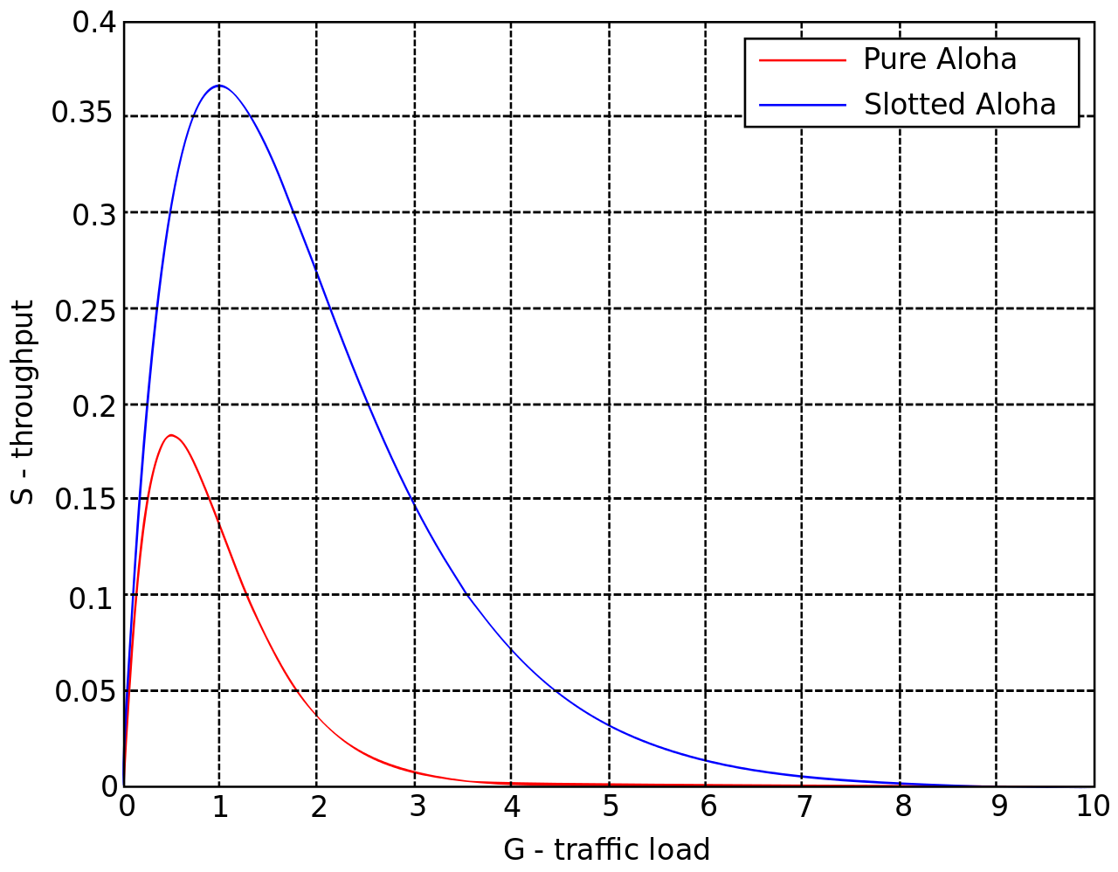
ALOHA throughput
It can be shown that traffic maxes out at
ALOHA: 18.4%
Slotted ALOHA: 36.8%
Assuming Poisson distribution of transmission attempts
Slotted throughput is double because the “before” collisions can no longer occur

Slide 85
Receiving transmissions with collisions
Collision does not always lead to packet loss
If a receiver hears from two or more stations and the signal from one station is much stronger than the rest, the receiver can receive the signal correctly “only” from this station: This is called capture effect.

Slide 86
Receiving transmissions with collisions
One receiver, multiple transmitters (transmit same packet)
With capture effect, adding new transmitters may improve reliability!

Slide 87
Receiving transmissions with collisions
99%
15%
35%
100%
R
-70.89dB
T4
-80.93dB
-83.02dB
-84.09dB
T3
T2
T1

Slide 88
Carrier Sense Multiple Access
Carrier Sense Multiple Access:
sense carrier
If idle,
send
wait for ack
If there isn’t one, assume there was a collision, retransmit
Should we transmit immediately once channel is idle?

Slide 89
Hidden terminal problem
Device C
Device A
Device B

Slide 90
Roadmap of the lecture today
Let us recall what was covered in the last lecture
Energy consumption calculation
Low-power wireless transmissions using backscatter mechanism
Backscatter like mechanism and LiFi
Communication layers and medium access control
Notes:
Here is the roadmap of the major topics that I am going to cover during the presentation. We have already covered the exponential growth of the internet of things; next, I will talk about the critical energy challenge that can severely hinder this massive growth and preventing us from realising this immense economic value enabled by the IoT.

Slide 91
Wireless Networking
Ambuj Varshney
ambujv@nus.edu.sg
Notes:
++ Thank you for inviting me to give this talk
++ In this talk, I will present a pathway that can enable us to make wireless embedded systems ubiquitous. I will describe my previous research efforts that tackle the critical challenges that limit the growth of wireless embedded systems. These are related to the growing energy asymmetry that exists between sensing, computation and communication blocks on these platforms.
++ Finally, I will conclude my talk by covering the research agenda that I would like to work on as a faculty member.

